Slide 1
Identification of Viral Pathogens Causing Gastroenteritis
Xiaoli (Lilly) Pang, PhD.
Molecular Virologist, Provincial Laboratory for Public Health
Professor, Department of Lab Medicine and Pathology
University of Alberta

Slide 2
Acute gastroenteritis (GE)
Global prevalence in children <5 years: diarrhea has been estimated to cause 700,000 deaths in 2011
~70% of deaths associated with diarrhea occur in the first 2 years of life
~30% of episodes of severe diarrhea are preventable by vaccination, i.e., rotavirus and cholera
~75% of diarrheal mortality are concentrated in 15 high-burden countries, yet data from these countries are scant
Globally, malnutrition is a key risk factor for the morbidity and mortality associated with diarrhea
Fischer Walker CL, et al. Lancet 2013;

Slide 3
GE in Canada
Disease burden
5 million annual episodes in Canada
70% attributed to an unidentified pathogen
10% of all pediatric ED visits
The numbers of ED visits are on the rise
Annual costs = $3.7 billion
Data underestimates true burden
90% of individuals with AGE do not seek for care
Under-diagnosing
Under-reporting

Slide 4
Viruses causing GE
The viruses were not considered as the important etiologic agents of GE until discovery of rotavirus in 1973.
Current studies showed that viral agent is major causative of diarrheal illnesses (> 50%) in developed countries although bacteria still play an important role in developing countries.

Slide 5
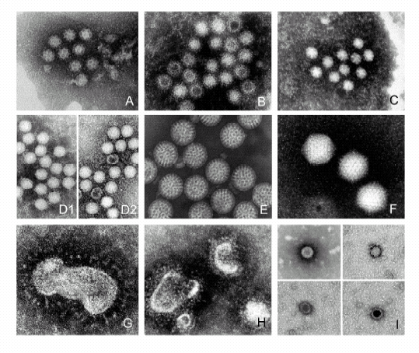
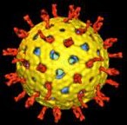
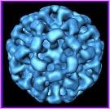
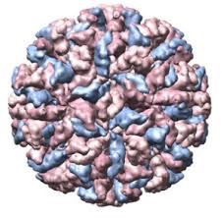
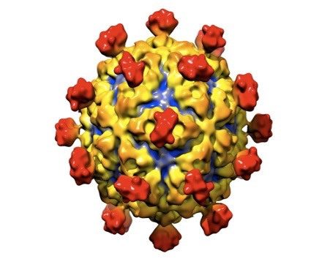
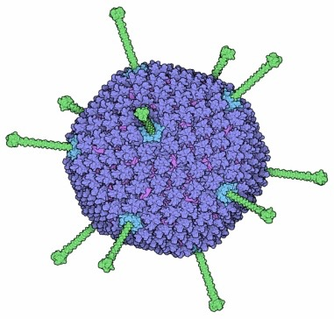
Most common GE viruses
Sapovirus
Norovirus
Astrovirus
(E) Rotavirus
(F) Adenovirus
Rotavirus
Norovirus
Sapovirus
Astrovirus
Enteric Adenovirus

Slide 6
Viruses causing GE
 | Rotavirus | Norovirus | Sapovirus | Astrovirus | Adenovirus
Genome | dsRNA | ssRNA | ssRNA | ssRNA | dsDNA
Culture in vitro | Yes, but difficult | no | no | Yes, but difficult | Yes, but difficult
Group/type in human | A,B,C,D,E,F and G 14 G and 23 P types | GI, GII (GII.4) and GIV | GI, GII, GIV, GV | 1 – 8 serotypes | 6 subgroups (A-F) 67 sero/genotype 40/41-EadV
Diagnostics (currently) | EM, EIA (RT-PCR) | RT-PCR | RT-PCR | EIA, RT-PCR | EM, EIA (PCR)

Slide 7
Viruses causing GE
Rotavirus – causes severe acute sporadic GE in young children
Norovirus – the most important agent of non-bacterial GE outbreaks in all ages
Sapovirus, astrovirus and enteric adenovirus – are commonly-seen pediatric GE in clinic and hospital ward

Slide 8
Noroviruses in sporadic GE
Norovirus is a leading cause of gastroenteritis across all settings and age groups. A systematic review of 31 studies in the both developed and developing countries summarized the annual prevalence:
10–15% of severe gastroenteritis cases in children < 5 years
9–15% of mild and moderate diarrheal disorders in various ages
In industrialized countries:
64,000 episodes of diarrhea resulting in hospitalization
900,000 clinic visits among children
In developing countries:
1.7–1.9 million outpatient visits
1.1 million hospitalizations
218,000 deaths each year in children
Patel MM et al. Emerg Infect Dis 2008; 4:1224–31.

Slide 9
Rotavirus in sporadic GE
Rotaviruses are the most importance of severe acute gastroenteritis in young children worldwide, responsible for ∼ 800,000 deaths annually
Seasonal winter/spring peak in temperate countries
Vaccine available:
The newest rotavirus vaccine, a live, oral, pentavalent human-bovine (WC3) reassorting vaccine (Rotateq®, Merck & Co., Inc.)
A monovalent attenuated human vaccine (Rotarix®, GlaxoSmithKline, Inc.) licensed by FDA
The vaccine program in Alberta ???

Slide 10
Viral GE in Alberta
One-year prospective study
Virus | Tested sample No. cases | Positive No. case | Prevalence (%)
Norovirus | 2316 | 374 | 16.15
Rotavirus | 2316 | 134 | 5.79
Sapovirus | 2316 | 87 | 3.76
Astrovirus | 2316 | 33 | 1.43
Enteric viruses | 2316 | 28 | 1.21
Mixed infection | 2316 | 36 | 1.55
All virus together | 2316 | 692 | 30.00
Pang et al. 2013

Slide 11
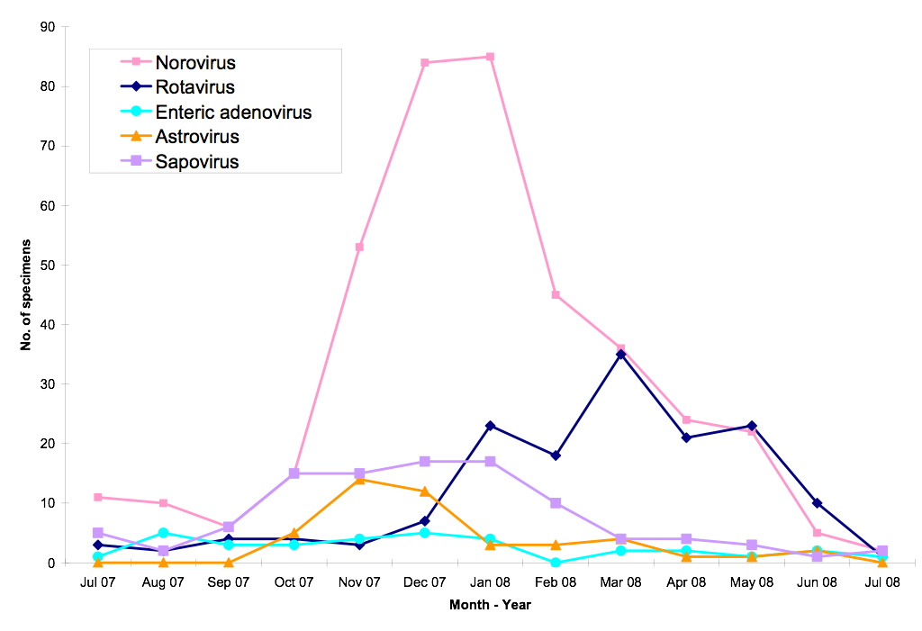
Seasonality of GE activity
One-year study in Alberta

Slide 12
Age distribution of GE
One-year study in Alberta
No. sample
Age (Year old)

Slide 13
Viral GE outbreak
Norovirus (NoV) is recognized as the most common cause of gastroenteritis outbreaks worldwide. NoV outbreaks occur frequently in nursing homes, health care institutions, cruise ships and have also been reported in schools and prisons
NoV was identified as a single-etiology in 1908 of 2819 (68%) among 4455 GE outbreaks reported from 2009 to 2010 in US
69,145 illnesses, 1093 hospitalizations and 125 deaths in these outbreaks
Ramani S, Atmar RL and Estes MK. Current Opinion, 2013

Slide 14
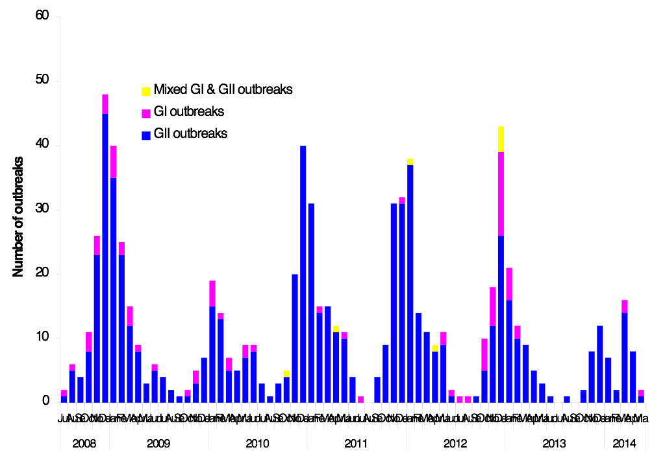
NoV GE outbreak in Alberta

Slide 15
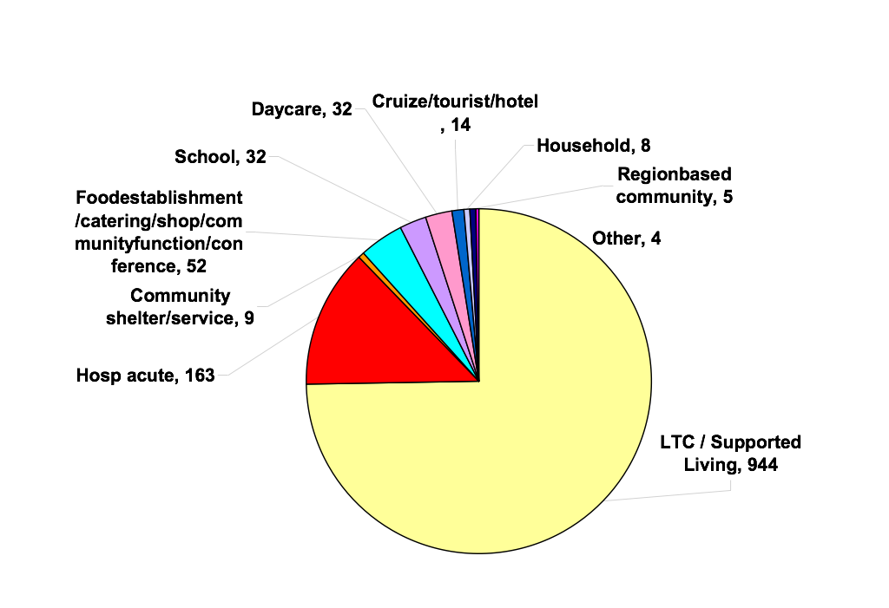
NoV GE outbreak settings
12.9%
74.7%

Slide 16
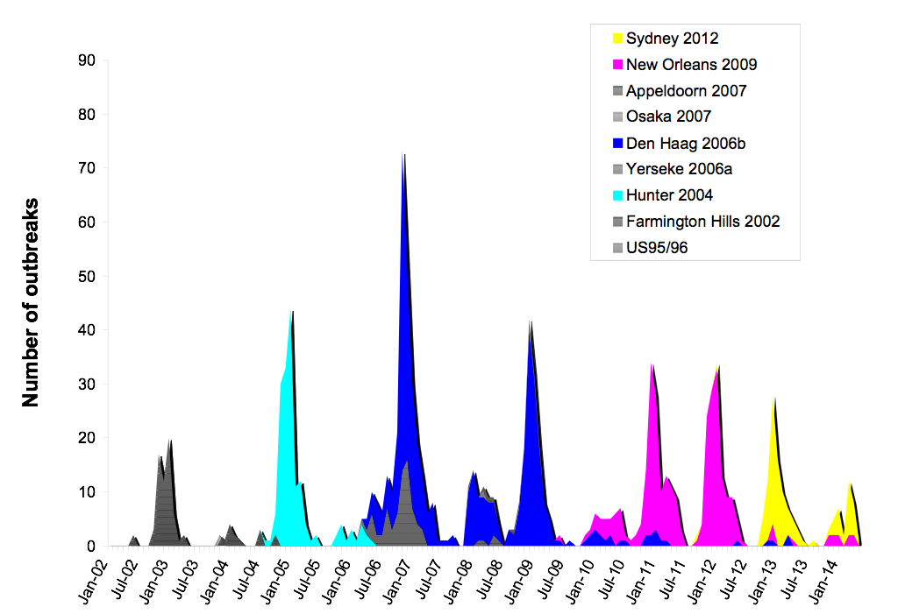
Predominant GII.4 variants
(associated GE outbreaks during 12 years)

Slide 17
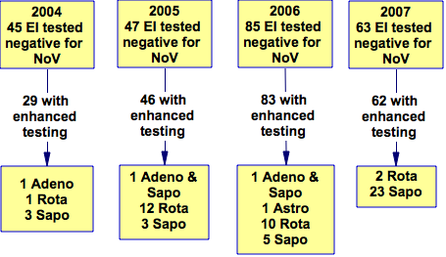
Enhanced testing for GE outbreaks (NoV negatives for further identification)
40.3%
(25/62)
13.7%
(5/29)
34.8%
(16/46)
20.5% (17/83)

Slide 18
Clinical perspectives
Clinical manifestations
Asymptomatic
The main symptoms of viral gastroenteritis are watery diarrhea and vomiting. The affected person may also have headache, fever, and abdominal cramps ("stomach ache”).
The symptoms and signs last for 2-3 days in most cases and however, viral shedding can continue for several weeks (potential transmission).

Slide 19
Clinical perspectives
Clinical management
Due to the lack of effective antiviral drugs against the viruses, treatment of patients with viral gastroenteritis has been mainly focused on supportive therapy.
Rehydration therapy is currently the most important management for severe cases to reduce mortality in the developing countries.
A prompt diagnosis of viral gastroenteritis is critical. Although it may not help for curing the disease, it would avoid unnecessary use of antibiotics and prevent disease transmission.

Slide 20
Knowledge Gaps
We test too few pathogens in too small numbers of patients and thus do not understand the true impact of AGEs on public and community health as well as socio-economics

Slide 21
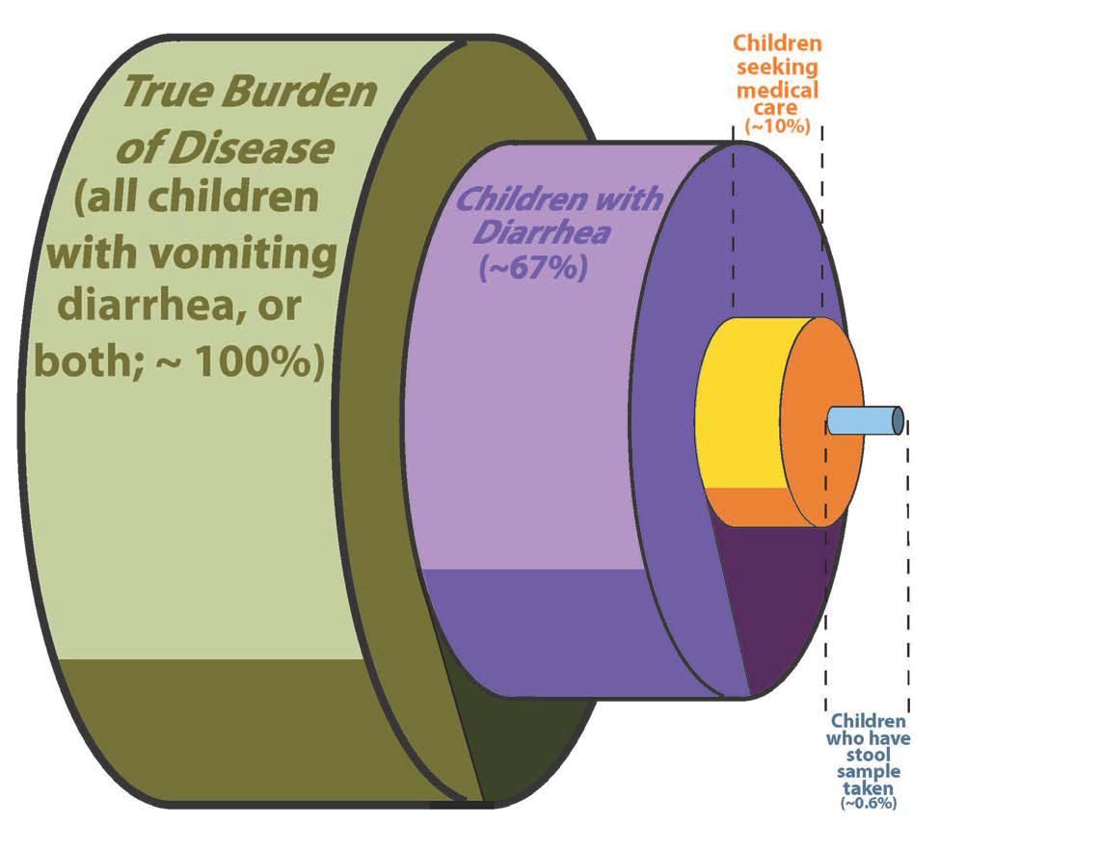
Challenge of disclosing true epidemiology of GE diseases

Slide 22

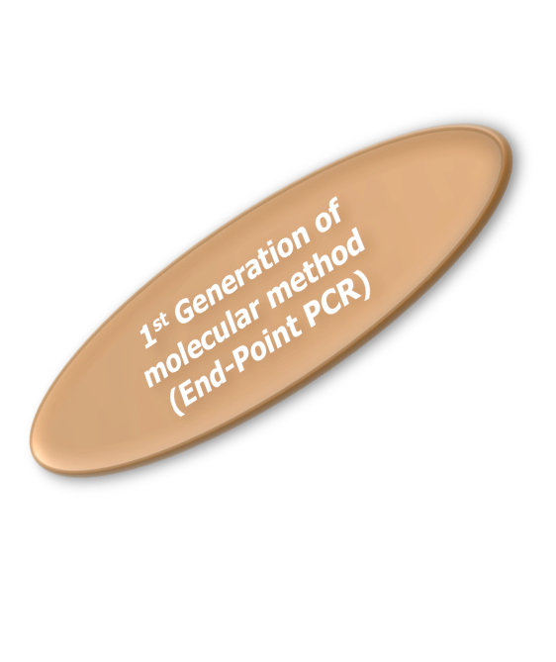

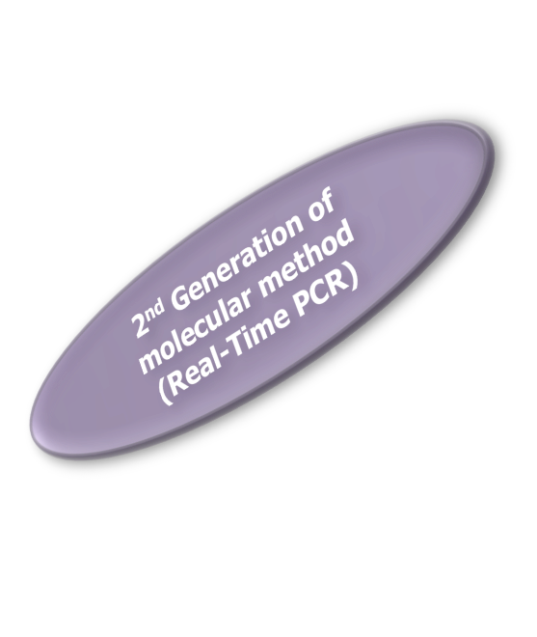
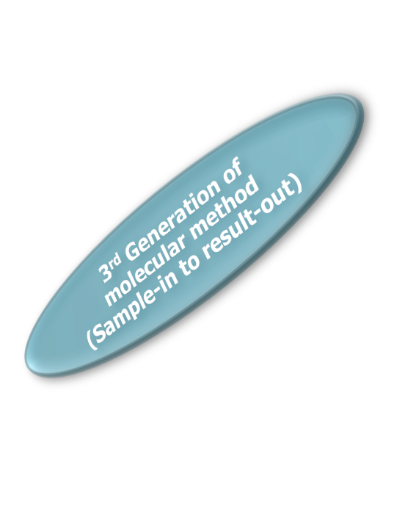
Technology evolution of molecular diagnostics on viruses
Improved performance over traditional methods
Faster turnaround time
Impact on patient care and management
1980
1985
1990
1995
2000
2005
Going Molecular
2012
Modification of Dr. Richard L. Hodinka slides

Slide 23
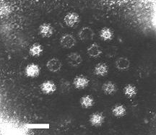
Electro Microscopy (EM)
Cheaper
Low sensitivity
Unable to differentiate norovirus from sapovirus and astrovirus (report all three as SRSV)
Well-trained and skilled staff
Results are subjective
Calicivirus (norovirus, sapovirus)
50 nanometers
EM pictures (www.epa.gov)

Slide 24
Enzyme immunoassay (EIA) for detection of rotavirus antigen
PremierTM Rotaclone (Meridian Diagnostics, Cincinnati, Ohio, USA) for detection of rotavirus Group A in fecal specimens
The kit insert description:
The Limit of detection: 5.0 x10⁵ particles/ml
Sensitivity against EM: 100%
Specificity against EM: 92%
There was no good data for comparison of EIA with PCR

Slide 25
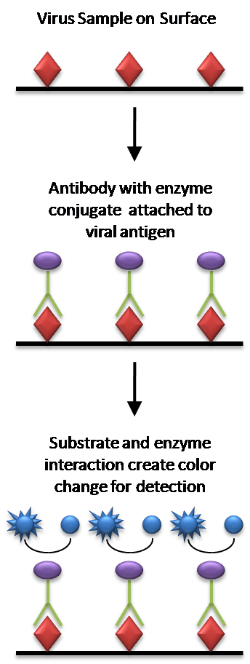
EIA for detection of norovirus antigen
Due to limited sensitivity and specificity, EIA is not recommended by CDC for clinical diagnosis.
R Biopharm AG (www.r-biopharm.com)
Denka Seiken Co. Ltd. Tokyo, Japan
(http://www.denka-seiken.co.jp)
SCKISUI VIROTECH, Germany
(www.sekisuivirotech.com)

Slide 26
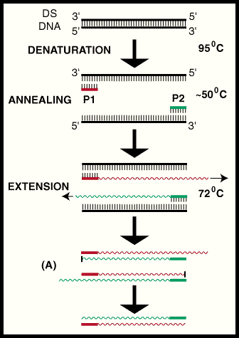
Conventional PCR
1st use for enteric viruses -1990’s
Very sensitive – able to detect one copy /PCR
Labor intensive comparable to the real time PCR
High risks of cross contamination –limit of use in diagnostic Lab
Need further confirmation by hybridization and/or sequencing

Slide 27
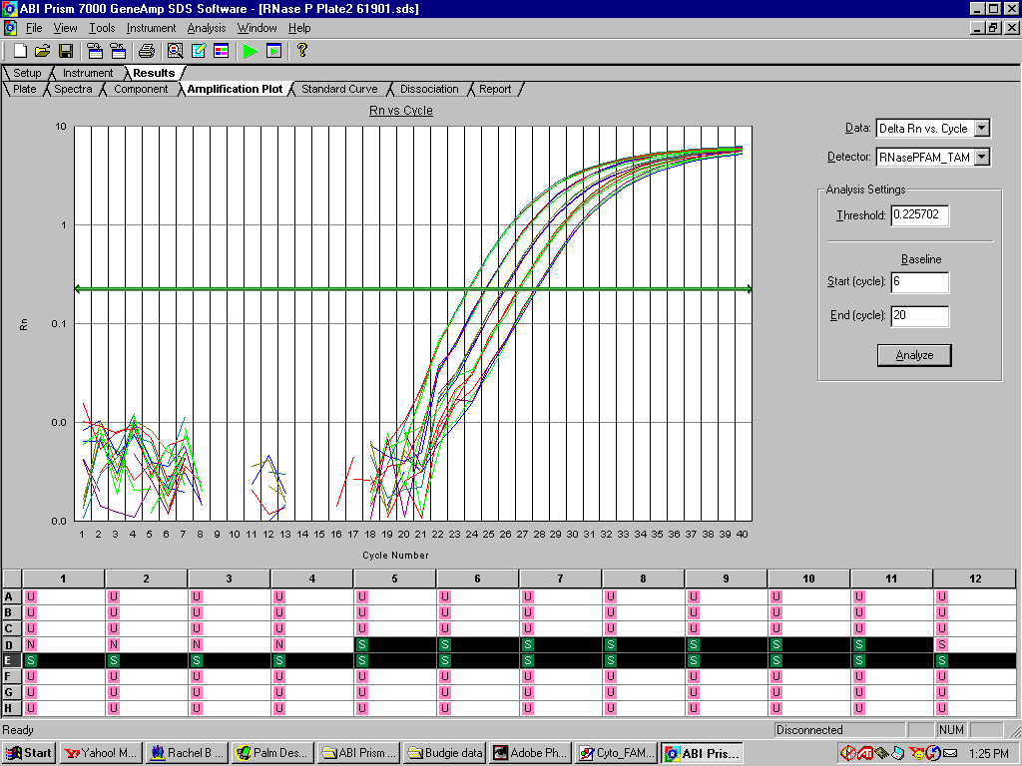
Review Real-time PCR
Detect amplification signals during the PCR reaction instead of “end-result” -so call “real-time”
Detection and quantitation are based on fluorescent signals (primers, probes, or products)

Slide 28
Real-time PCR
Why’s so cool about the real-time PCR?
Reduce turn-around testing and report time
Simultaneous amplification, detection, quantification, and data analysis
Prevent cross-contamination (a critical issue in diagnostics)
Closed tube and reacting system
No additional step of manipulates required after sample is loaded
Contamination control
Detect at a wider linear range (7-8 logs)
Highly reproducible
Higher sensitivity and specificity compared to traditional PCR assay
Perform multiplex testing for several viruses simultaneously
Flexible for manual or automatic procedure as desired

Slide 29
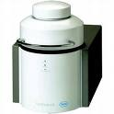
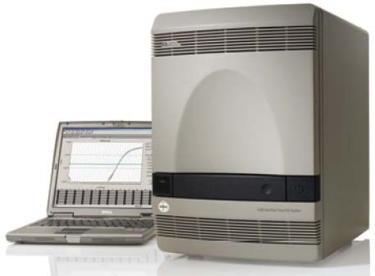
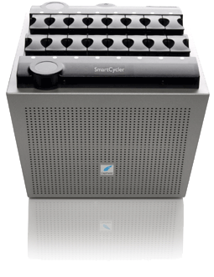
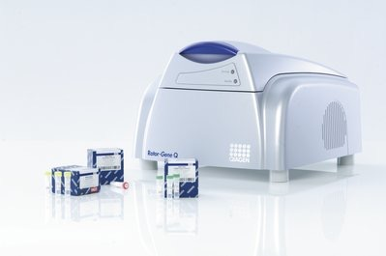
Common instruments of real-time PCR
ABI system
LightCycler
SmartCycler
Rotogene

Slide 30
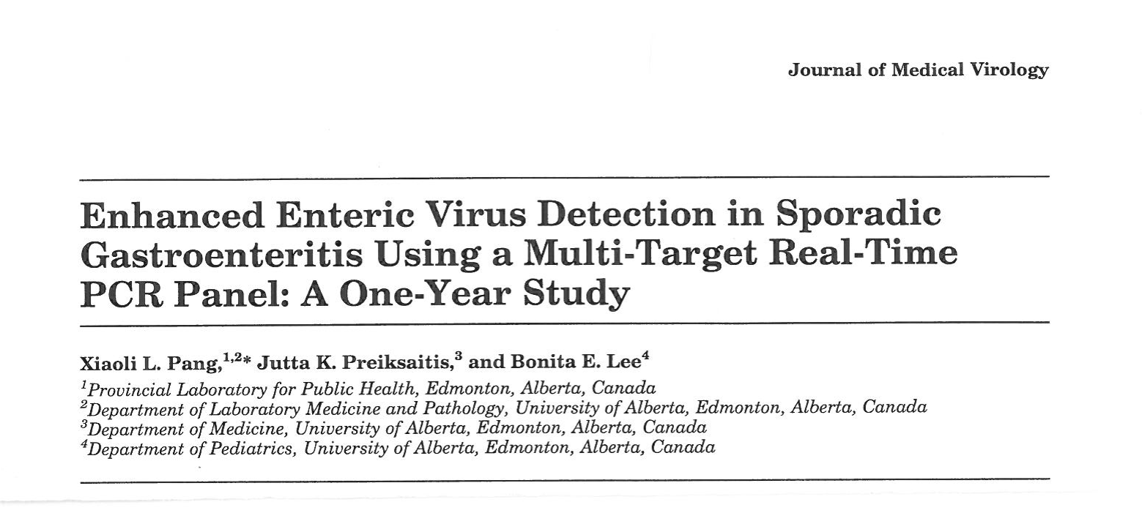
In-house Real-time PCR
GEV panel

Slide 31
Targeting genes used in
in-house PCR GEV panel
Norovirus GI and GII –Junction of Polymerase and Capsid
Rotavirus Group A- No structure protein
Sapovirus - Junction of Polymerase and Capsid
Astrovirus – Polymerase and Capsid
Adenovirus- Hexon

Slide 32

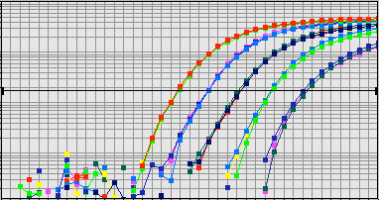
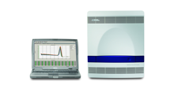
In-house PCR GEV panel
10% of stool samples suspension
Extraction of viral nucleic acid
Hours?
Amplification and detection

Slide 33













200ul of 10% Suspension of Stool Sample with H₂0
100ul Total Nucleic Acid
RT reaction
20ul
Multiplex NoV GI and GII
Multiplex RotaV and AdV
Multiplex AstroVV and SapoV
ABI PRISM7500
PCR
Specific Primers and TaqMan Probes mix with Universal DNA Master Mix
NoV GI and GII
Pos or Neg
RotaV
Pos or Neg
AdV
Pos or Neg
AstroV
Pos or Neg
SapV
Pos or Neg

Slide 34

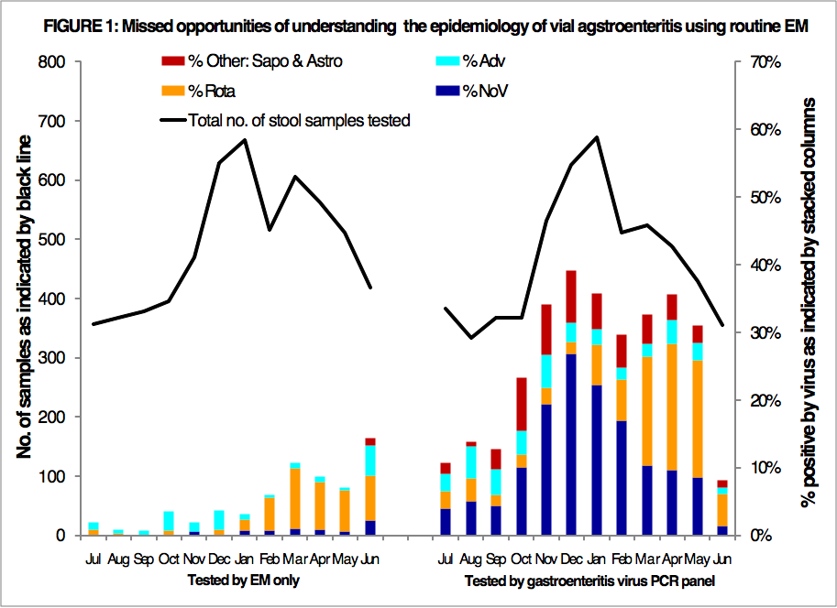

Slide 35
Commercial available assays
Assay | License/Approval information | Principle of the test | Instrument | Vendor
AndiaTee® Norovirus real RT-PCR kit | CE-IVD | Real time RT-PCR Taqman | ABI system and a comparable instrument (e.g. Roche 480, Stratagene, Qiagen/Corbett) | AndiaTee® GmbH Komvesthein, Germany
RealStar® Norovirus RT-PCR Kit | CE-IVD | Real time RT-PCR Taqman | m2000rt, Mx 3005P™ VERSANT™ kPCR ABI 7500 /7500 Fast LightCycler® 480 Rotor-Gene™ 3000/6000, Rotor-Gene™ Q 5/6 plex | Altona Diagnostics GmbH Hamburg, Germany
Xpert Norovirus kit | CE-IVD | Real time RT-PCR | Xpert® system | Cepheid CA, US
Luminex xTAG GPP | FDA cleared/ Health Canada approved-IVD | Multiplex RT-PCR and Liquid Array | Luminex system | Luminex TX, US
FilmArray GI panel | FDA cleared-IVD | Nested RT-PCR and Film Array | FilmArray platform | BioFire Diagnostics UT, US
Verigen® Enteric Pathogens Necleic Acide Test (EP) | FDA cleared-IVD | Multiplex RT-PCR and array hybridization | Verigene platform | Nanosphere, Inc. IL, US
IVD - In vitro diagnostic use

Slide 36

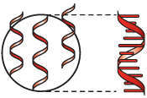


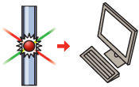
FDA/Health Canada-cleared molecular multiplex GE tests: Luminex xTAG GGP
Sample preparation
Nucleic acid extraction
Pre-PCR/PCR
Multiplex amplification
Bead hybridization
Post-PCR
Data acquisition
and
Analysis
Luminex xTAG GGP Package Insert

Slide 37
FDA/Health Canada-cleared molecular multiplex GE tests: Luminex xTAG GGP
Target (Analytes) | Sensitivity | Specificity
Bacteria & Bacterial Toxins
Shigella | 97.7% | 97.8%
Campylobacter | 97.5% | 97.8%
Yersinia enterocolitica | N/A* | 100.0%
Enterotoxigenic E. coli (ETEC) LT/ST | N/A* | 97.3%
E. coli O157 | 88.2% | 98.8%
Shiga-like Toxin producing E. coli (STEC) stx 1/stx 2 | 100.0% | 99%
Salmonella | 82.1% | 99.1%
Clostridium difficileToxin A/B | 97.7% | 94.9%
Vibrio cholerae | N/A* | 100.0%
Viruses
Adenovirus 40/41 | 100.0% | 100.0%
Rotavirus A | 94.7% | 99.8%
Norovirus GI/GII | 93.5% | 98%
Parasites
Giardia lamblia | 100.0% | 98.2%
Cryptosporidium | 87.5% | 100%
Entamoeba histolytica | 100.0% | 99.4%
*Due to low sample size, clinical sensitivity was not assessed for ETEC, Yersinia enterocolitica and Vibrio cholerae. However, analytical accuracy for these analytes was demonstrated in the limit of detection and reactivity studies with cultural isolates or plasmids.

Slide 38
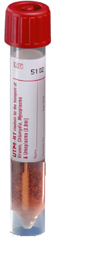

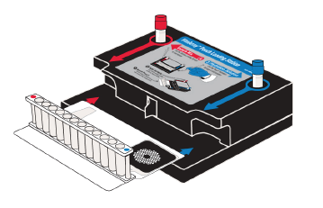
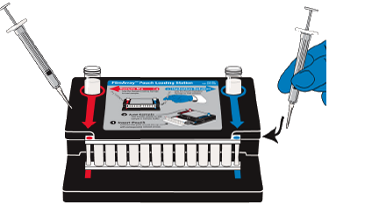
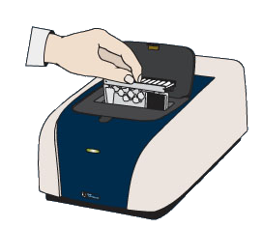
FilmArray GE Panel
(BioFire Diagnostics)
2 minutes of hands-on-time !
Add Sample
to Pouch
Add Buffer
to Pouch

Slide 39
FilmArray GE Panel
(BioFire Diagnostics)
Bacteria
Diarrheagenic E. coli
• ETEC
• EPEC
• STEC/EHEC
-O157:H7
• EIEC
• EAEC
Aeromonas spp.
• Salmonella spp.
• Vibrio spp.
-V. cholorae
• Shigella spp.
-S. dysenteriae
• Campylobacter group
• Yersinia enterocolitica
• Clostridium difficile
-C.difficile Nap1*
• Plesiomonas shigelloides*
Viruses
Norovirus (GI, GII, and GIV)
Adenovirus F (40/41)
Rotavirus (A, B, and C)
Human Astrovirus*
Sapovirus*
Protozoa
Cryptosporidium group
Giardia lamblia
Entamoeba histolytica
Cyclospora cayetanensis*
*Assays added to panel subsequent to presented data set.
http://filmarray.com/the-evidence

Slide 40
Current GEV diagnostic testing
(in Edmonton ProvLab)
Stool sample sent
to ProvLab
Viral GE Outbreak
Viral GE Sporadic
Hospitalized and ED patients
Out patients
In-house PCR GEV panel for
Rotavirus Norovirus
Sapovirus Astrovirus
Adenovirus
EM test for
rotavirus,
adenovirus
SRSV

Slide 41
Sample Collection
Stool sample:
Stool is the classic specimen of choice for laboratory testing of GIV. A few grams of stool sample (pea-size) are sufficient for GIV detection by EM, antigen testing or nucleic acid testing (NAT) methods.
Rectal swab:
Obtaining stool specimens is challenging especially in the home setting. There is some recent evidence supporting the use of rectal swab which gave equivalent results of detecting GIV using real time RT-PCR. However, rectal swabs are not recommended for testing by EM and antigen detection test (EIA/ELISA) due to insufficient quantity of fecal material. It is easier and more convenient to collect a rectal swab but more data and validation is needed to support its use as a routine diagnostic sample.

Slide 42
Storage and transportation
In general, the best test results are obtained by testing fresh stool samples, especially using methods dependent on the morphological appearance of virus, i.e., EM
EM: stool samples should be stored at 4ºC immediately after collection and promptly transported to the laboratory for processing
NAT: best stored in -70ºC for long-term storage. On the other hand, enteric viruses can be detected in stool samples after storage at -20ºC for three years.
Stool samples can be shipped on wet or dry ice, depending on their storage conditions (e.g., short- or long-term storage).

Slide 43
Testing Frequency
For investigation of GIV outbreak, testing up to six samples per outbreak is considered sufficient for identification of GIV and ruling out of GIV as the causative agent. Once two stool samples from the same outbreak are tested as positive, GIV can be confirmed as a causative agent. If all six samples are negative, an outbreak can be defined as non-GIV associated and further investigation for other pathogens may be required.
Repeat testing of GIV for the same patient using molecular testing should not be performed except for special clinical reasons as GIV can be shed for weeks to months especially in immunosuppressed patients.

Slide 44
Acknowledgement
Dr. Bonita Lee
Dr. Graham Tipples
Dr. Marie Louie
Staff in Research Laboratory in Edmonton, ProvLab Staff in Virology and Molecular Diagnostic Laboratory in Edmonton and Calgary, ProvLab
AHW enhancement initiatives
Collaborative teams participating in the outbreak investigation

Slide 45
Thanks
Questions

