Slide 1
Clinical Application and Interpretation of Molecular Microbiological Methods
Kurt D. Reed, M.D.
Professor and Vice Chairman
Department of Pathology and Laboratory Medicine
University of Wisconsin – Madison, USA

Slide 2
Outline
Brief history of the development of molecular microbiology
Goals for molecular microbiology in the clinical laboratory
Major test platforms and methods
Interpreting results – possibilities, practicalities and pitfalls
What does the future hold?

Slide 3
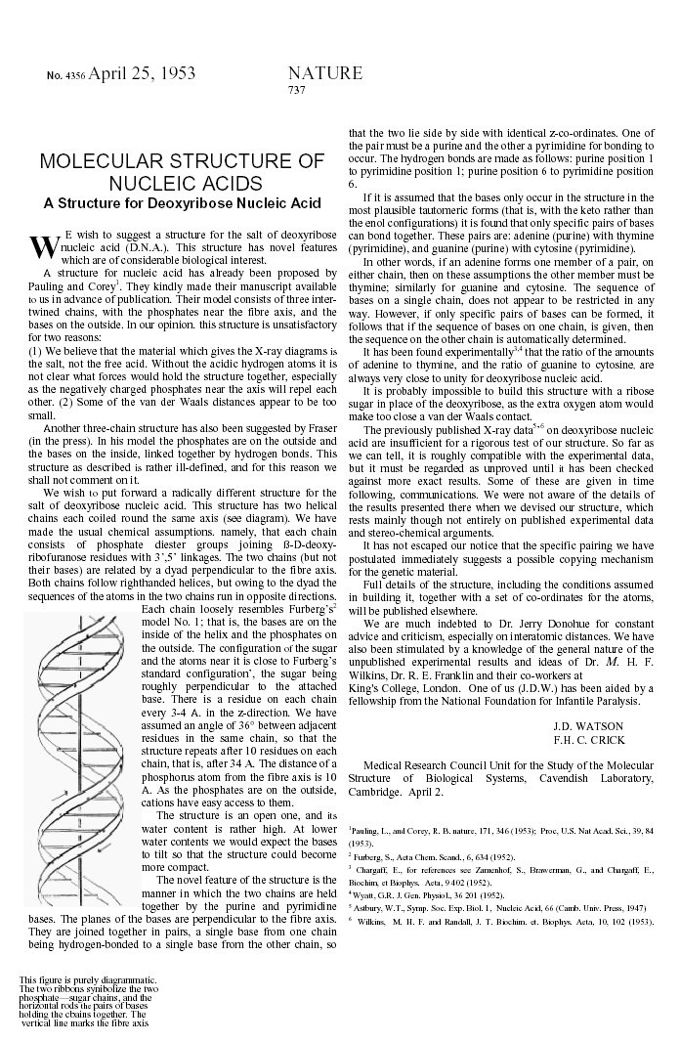
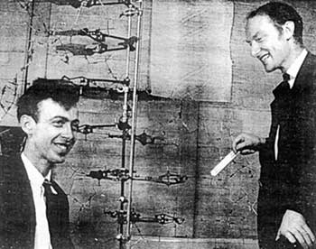
> 10, 700 citations

Slide 4
Important Milestones in Molecular Biology
Host-controlled restriction-modification in bacteriophages
Chemical and enzymatic DNA sequencing
Polymerase chain reaction (PCR)
Pulsed-field gel electrophoresis (PFGE), MLST and other genetic typing methods
Random fragment sequencing and genome assembly
“-omics technology (transcriptomes, proteomes, metabolomes)
Next generation sequencing (NGS)
Essentially every new discovery in molecular biology has benefited the clinical laboratory

Slide 5
Goals for Molecular Microbiology in the Clinical Laboratory
Identify pathogens
  Non-culturable, fastidious and slow growing agents (HPV, Hepatitis B)
  Highly infectious agents too dangerous to culture (Brucella, Coccidioides)
Localize infectious agents in tissue
  e.g. Viruses, Toxoplasma,
Quantify pathogens for prognostic and treatment purposes
  HIV, CMV, Hepatitis B and C
Differentiate antigenically similar agents
  HPV genotypes to determine cancer risk
Hospital and community epidemiology
Antiviral/ antibacterial susceptibility testing

Slide 6
Practical Considerations for Patient Care
Reduce turn-around-times for results
  Decrease length of stay
  Reduce unnecessary antibiotic use and allow for more focused treatment when it is necessary
Improve sensitivity and specificity
  e.g. vastly improved detection of sexually transmitted infections
Reduce costs
  Molecular tests may be expensive to the laboratory but can translate into cost savings to the institution
Standardize result reporting across hospitals
  e.g. industry standards for quantification of viruses

Slide 7
Categories of Molecular Methods
Hybridization methods – generally good for identification, can be more sensitive than culture, but often not as sensitive compared to amplification methods. Early adoption of these methods by many clinical labs.
Amplification methods – excellent sensitivity and specificity. Contamination and workflow issues had to be overcome before useful clinically.
Sequencing and enzymatic digestion of nucleic acids – fueling an explosion of knowledge in pathogen discovery, mechanisms of disease and molecular epidemiology. Current use by large laboratories and reference labs.

Slide 8
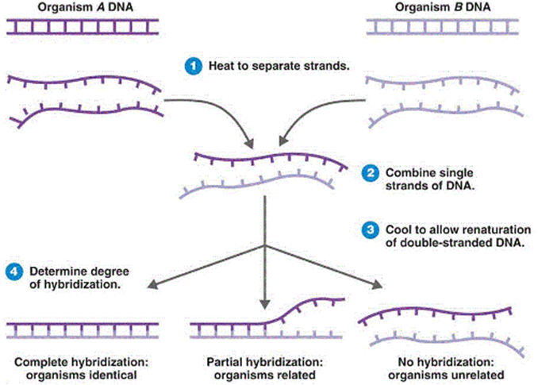
Nucleic Acid Hybrization
Looks simple but many things can go wrong. Need highly accurate and consistent results to be useful in the clinical setting.

Slide 9
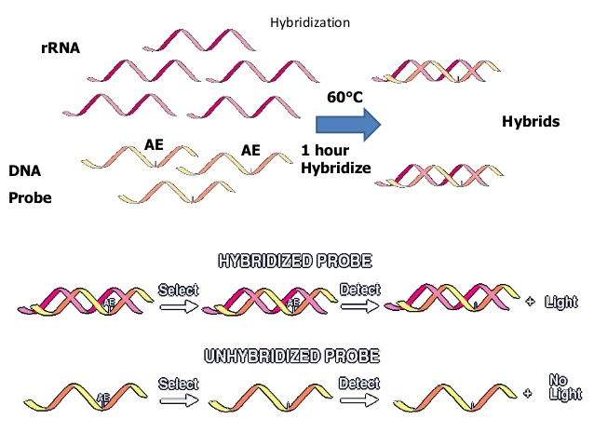
Steps Involved in Hybridization Reactions
Produce and label single stranded probes
Prepare single stranded target nucleic acid
Anneal target an probe under appropriate conditions of stringency
Detect hybridization reaction
  Solution format
  Solid support format
Solution format hybridization

Slide 10
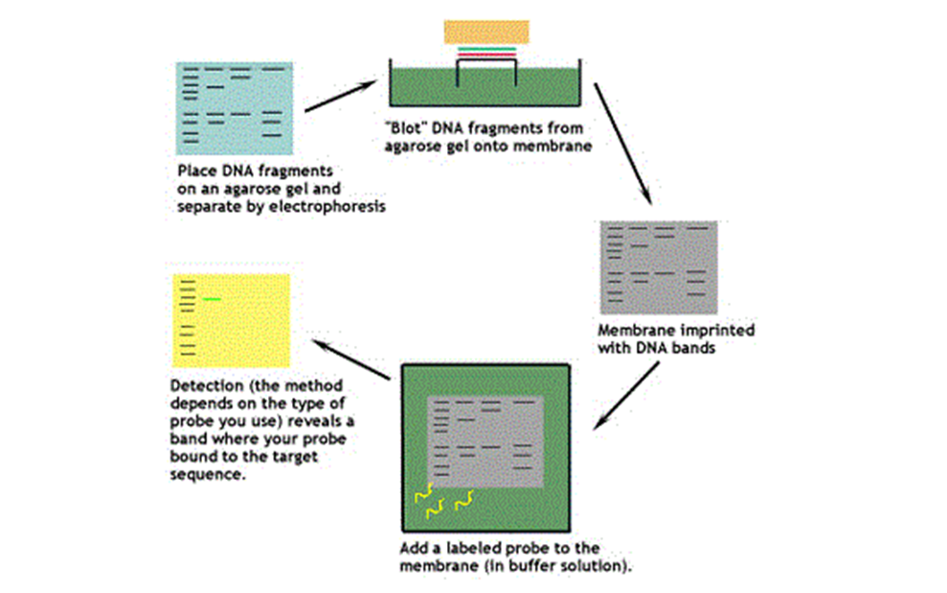
Southern Blot Hybridization
Too many steps, too time consuming, and too subjective to be practical in many laboratories.

Slide 11
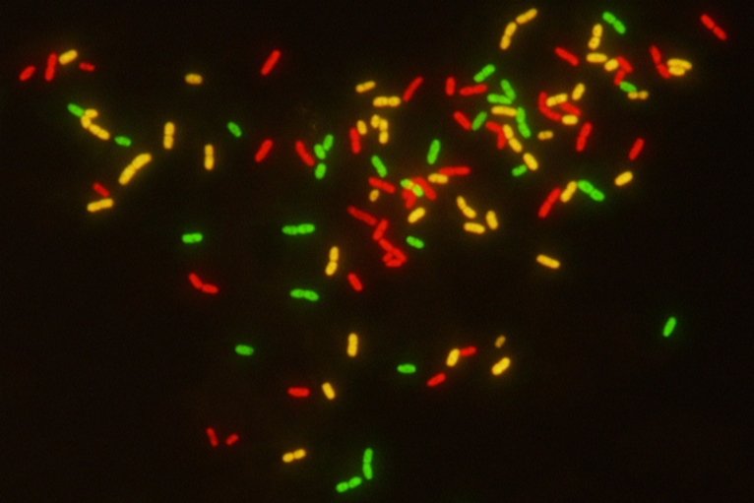
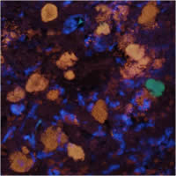
In situ Hybridization
Allows pathogens to be identified and localized within tissues.
Identification of bacteria from positive blood cultures PNA-FISH
Localization of invasive E. coli in colonic tissue

Slide 12
Applications of Hybridization Techniques
Direct detection of pathogens: e.g. Group A Streptococcus, N. gonorrhea, C. trachomatis. Replaced traditional culture in many labs.
Identification of culture isolates – dimorphic fungi, mycobacteria
Advantages included rapid turn-around-time for results. Good sensitivity and specificity compared to culture.
Disadvantages include relative insensitivity compared to amplification techniques.

Slide 13
Amplification Techniques
Target amplification
  PCR – thermal cycling required. (Initial fears of unacceptable rates of contamination have been overcome by a combination of chemical/enzymatic decontamination of amplicons, single tube methods and workflow design.)
  Isothermal amplification
    Nucleic acid sequence based amplification (NASBA)
    Transcription mediated amplification (TMA)
    Strand displacement amplification (SDA)
    Loop mediated isothermal amplification (LAMP)
Signal amplification
Probe amplification

Slide 14
16S rRNA Genes
Found in all bacteria
Accumulate mutations SLOWLY hence they have been used as “molecular clocks”
Conserved regions of the gene are targets of “broad-range” primers for any/all bacteria
Highly variable regions of the gene provide unique signature sequences to identify the bacterium

Slide 15
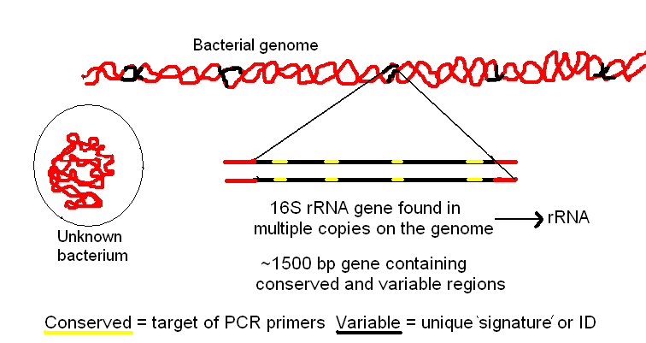

Slide 16
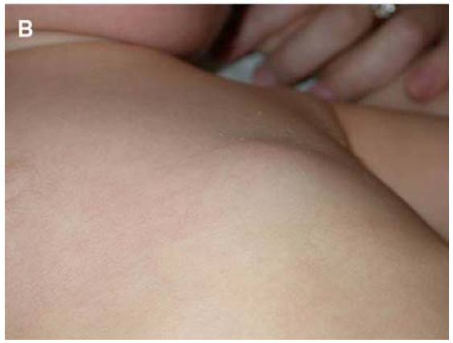
Clinical Application of PCR in Infectious Diseases
10 month old boy presented with a hard lump on his chest that had developed over a few days. The mass was 2x3 cm, tender to touch, and slightly red.
No fever, vomiting, diarrhea, rash, masses elsewhere, trauma or injury, recent travel, ill contacts.
Luegmair et al. J Child Orthop (2008)

Slide 17
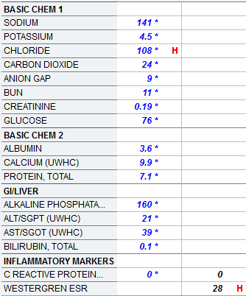
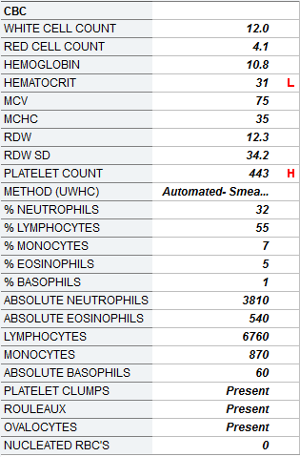
Labs
*Blood cultures negative

Slide 18
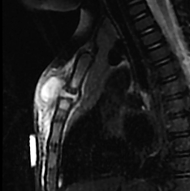

Slide 19
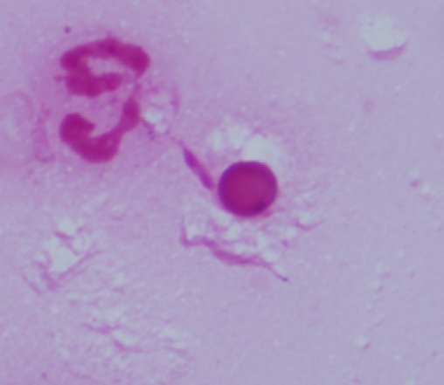
Kingella kingae
RARE Gram-negative rod on smears
No growth on cultures
16S rDNA PCR 99.8% homology with Kingella kingae
Yagupsky et al. Pediatrics. 2011

Slide 20
Difficult Cases Still Remain a Challenge
Previously health 41 year old white male developed abdominal pain in 2009.
Pain persisted and was associated with intermittent joint pain with effusions and profound fatigue.
Evaluated in 2010 where CT of abdomen showed diffuse retroperitoneal and mesenteric lymphadenopathy (many nodes 3-4 cm in size) and ascites. He declined biopsy.
Quantiferon positive – treated with INH for 9 months

Slide 21
Rheumatologic Assessment
Fever with night sweats
25 lb weight loss
Microscopic hematuria
Anemia of chronic disease
ANA 1:80, RF negative, HIV negative
Serositis with pleural, pericardial and peritoneal fluid
Repeat CT scan shows persistent splenomegaly and enlarging lymphadenopathy
DDX included lymphoma, sarcoidosis, autoimmune diseases, etc.

Slide 22
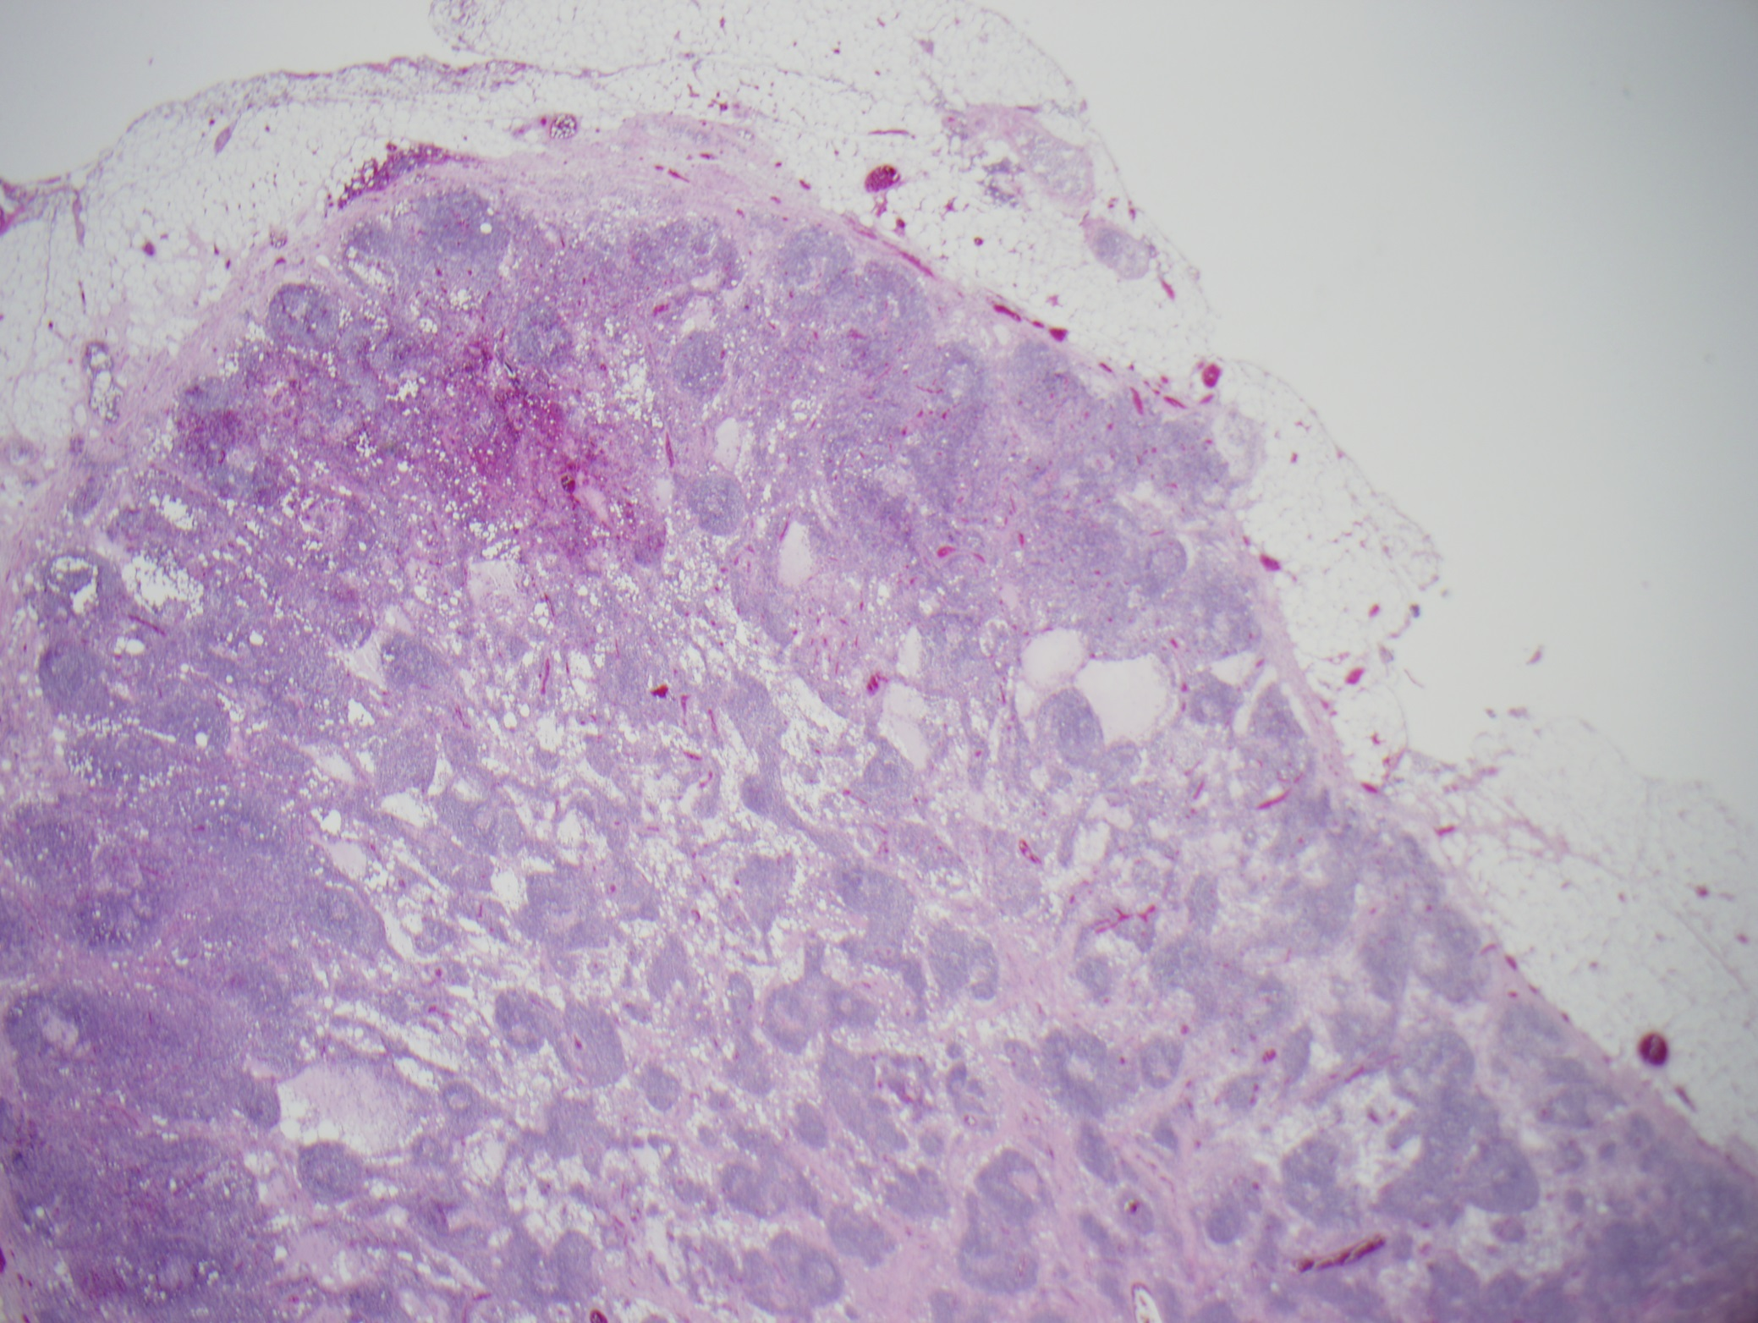
Mesenteric Lymph Node – H&E

Slide 23
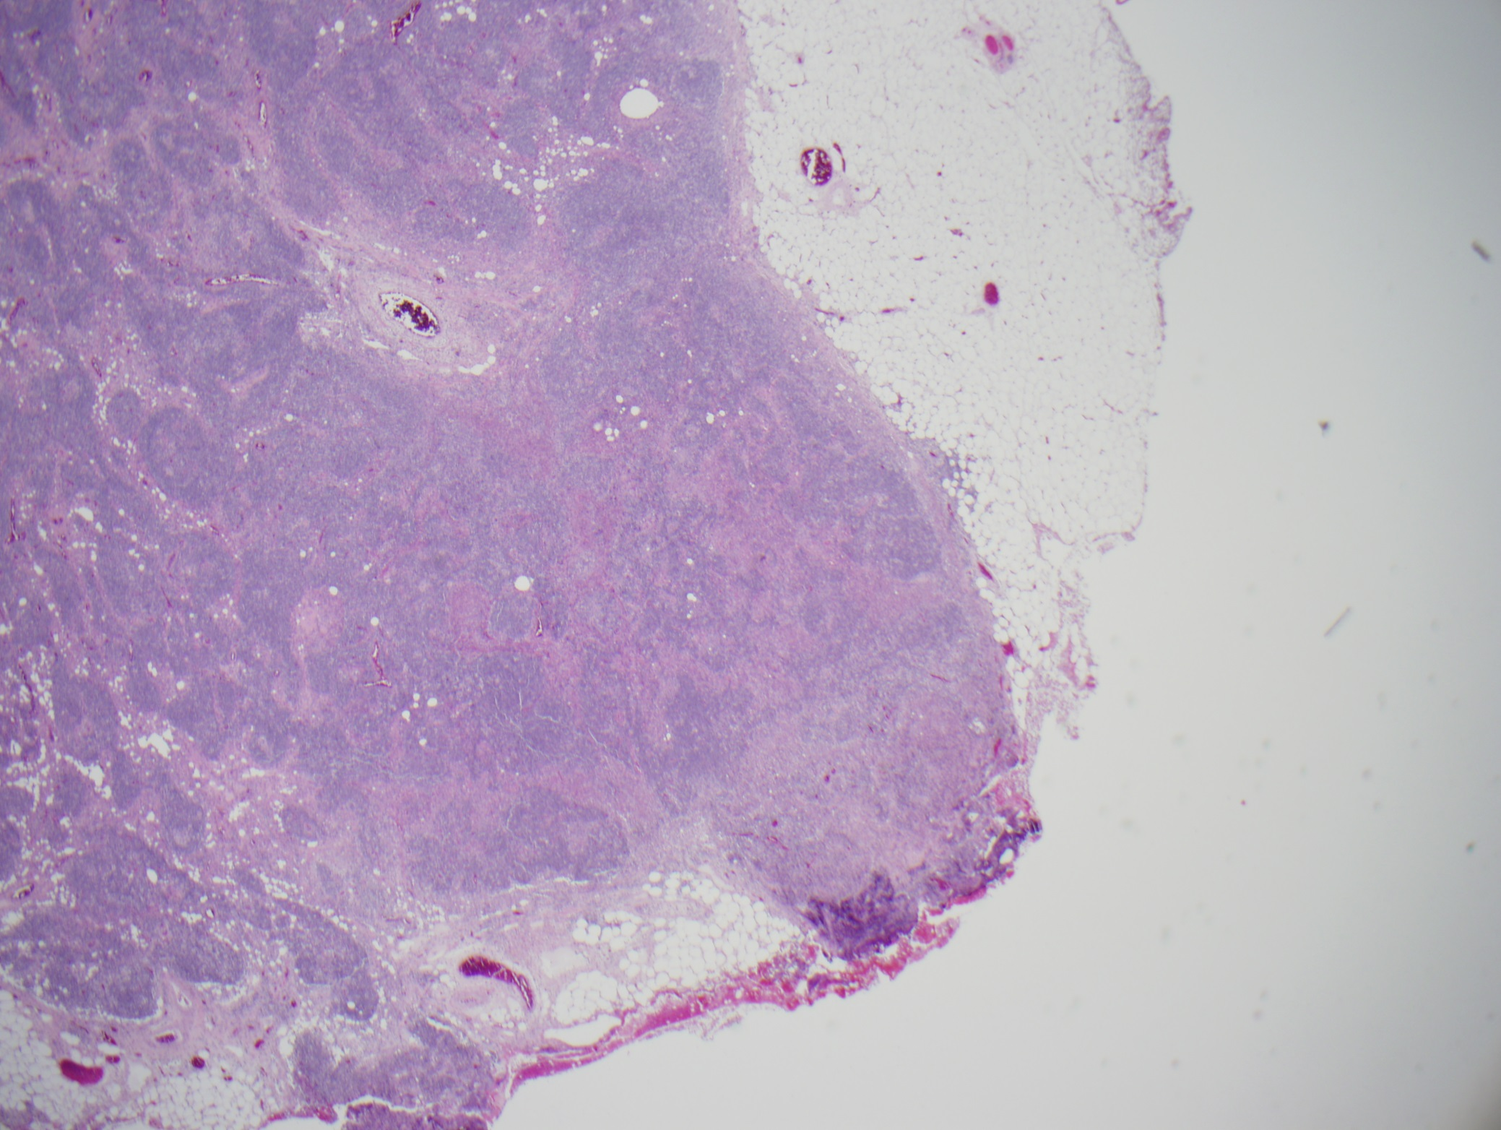
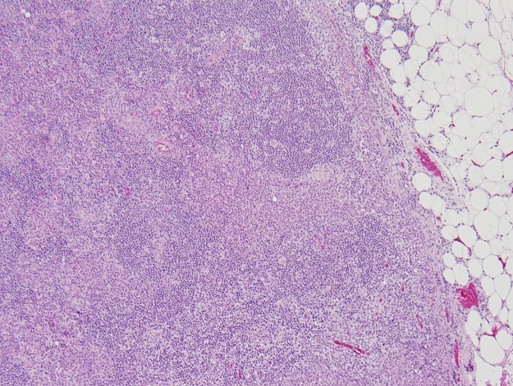
Irregular areas of necrosis
and neutrophilic infiltrate

Slide 24
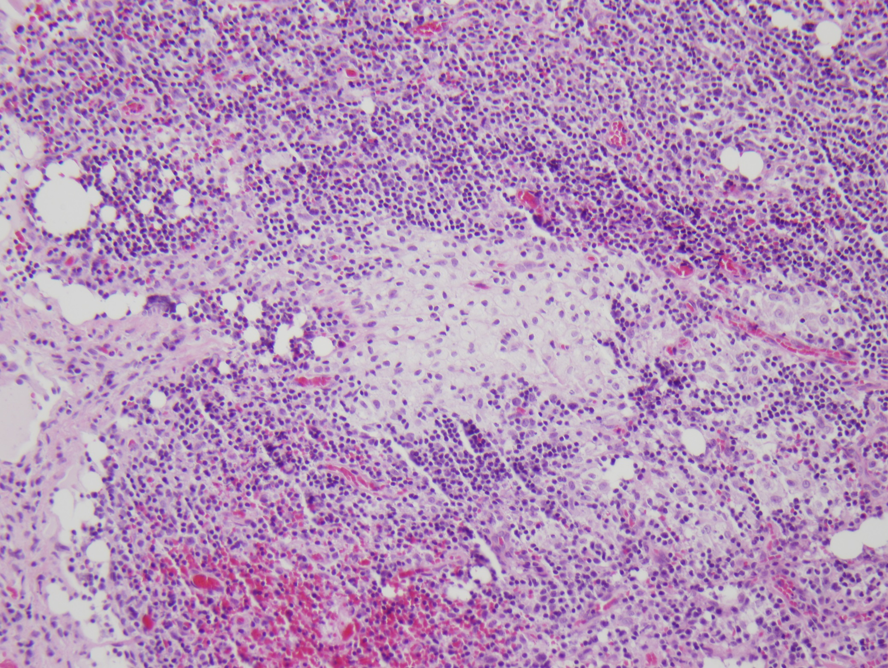
Foamy macrophages

Slide 25
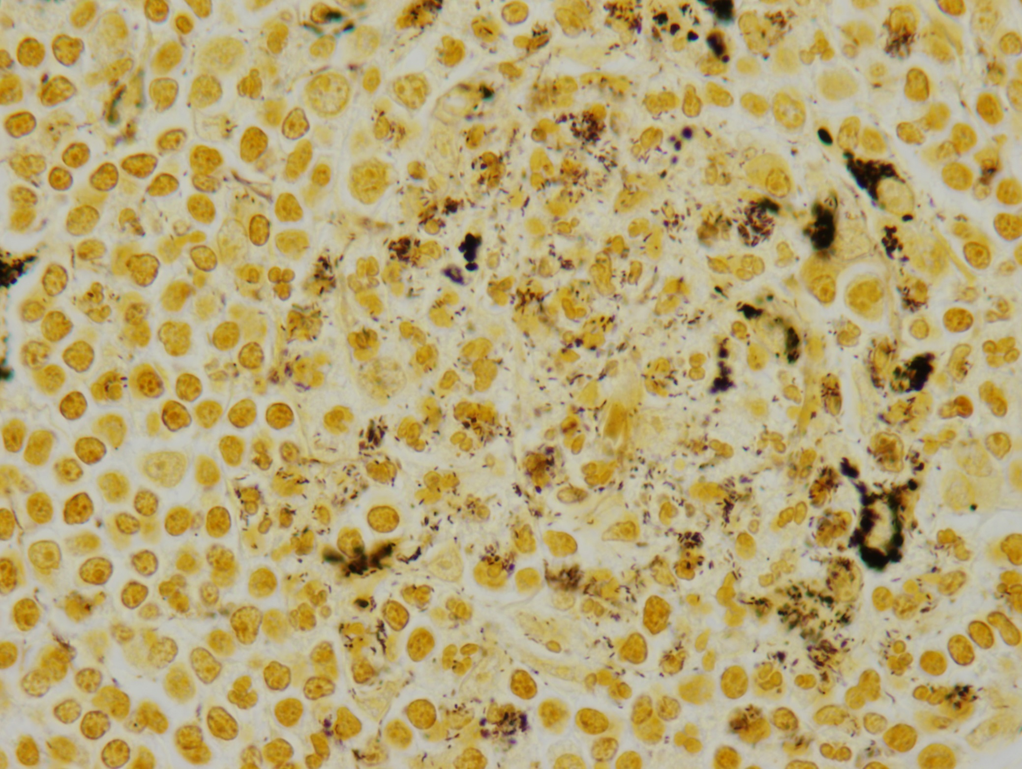
Warthin – Starry Silver Stain –
numerous small intra and extracellular bacilli

Slide 26
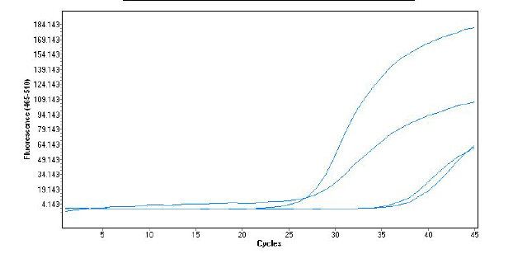
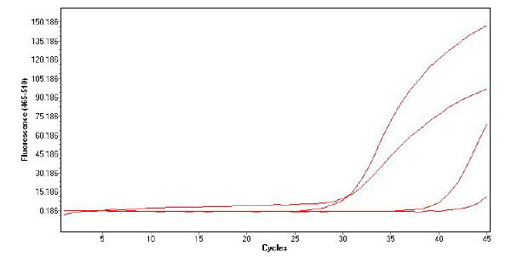
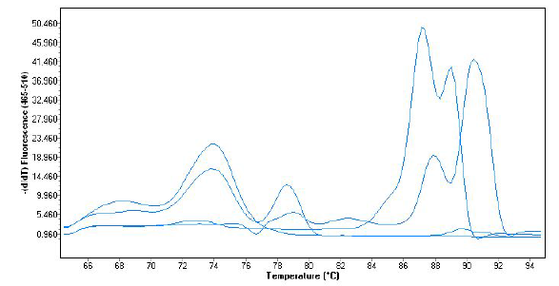
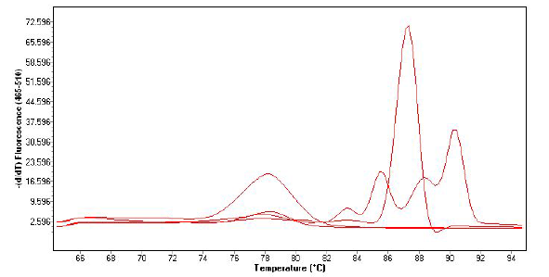
16S PCR and Sequencing, 5’- end 452/452 Homology with
Tropheryma whipplei – Twist-Marseille strain
5’ 16S Real Time PCR Amplification
3’ 16S Real Time PCR Amplification
Tissue
Tissue
Positive Control
Staph. aureus
Positive Control
Staph. aureus
LN Biopsy
M-13-0103
LN Biopsy
M-13-0103
Negative
Controls
Negative
Controls
5’ 16S Real Time PCR Melting Curve
3’ 16S Real Time PCR Melting Curve
Tissue
Positive Control
Staph. aureus
LN Biopsy
M-13-0103
Tissue
Positive Control
Staph. aureus
LN Biopsy
M-13-0103
Negative
Controls
Negative
Controls

Slide 27
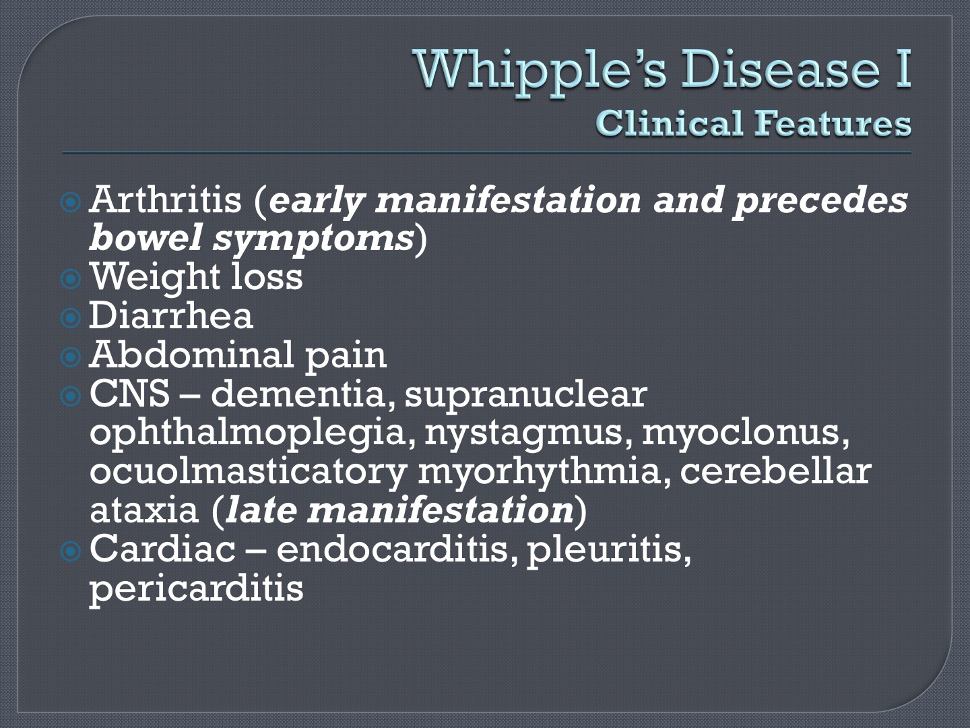

Slide 28
Selection of Gene Targets for Sequence-based ID
Bacterial -16S gene, RNA polymerase B
Fungal - Internal Transcribed Spacer (ITS) regions btw 18S, 5S, and 28S genes
Viral - No universal targets have been developed
  Genetic diversity without common link across all genera of viruses

Slide 29
Increased Role of 16S PCR in Clinical Practice
Direct detection from tissues (must be a normally sterile site with no endogenous mixed flora)
  Osteomyelitis
  Lymphadenitis
  Septic arthritis
  Endocarditis
  Bacteremia with unusual organisms e.g. Bartonella, Coxiella, Mycoplasma
Organism isolated from microbiology culture
  Difficult to ID by conventional methods
    Fastidious/atypical growth is not ideal for commercial ID systems
      Nutritionally variant Streptococcus
      Hemophilus sp. / Aggregatibacter sp.
      Actinomyces sp. / Nocardia sp.
      Legionella sp. / Mycoplasma
      Mycobacteria

Slide 30
Types of PCR
Reverse transcriptase – PCR
  Used to detect RNA viruses and prepare cDNA from mRNA
Nested PCR
  Enhanced sensitivity and specificity but with risk of contamination
Multiplex PCR
  Widespread use in the diagnosis of respiratory viruses and is starting to be used for stool pathogens
Competitive quantitative PCR (QPCR)
Real time PCR

Slide 31
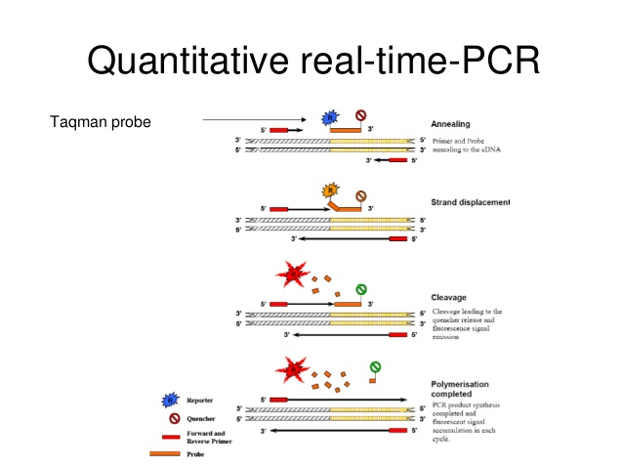
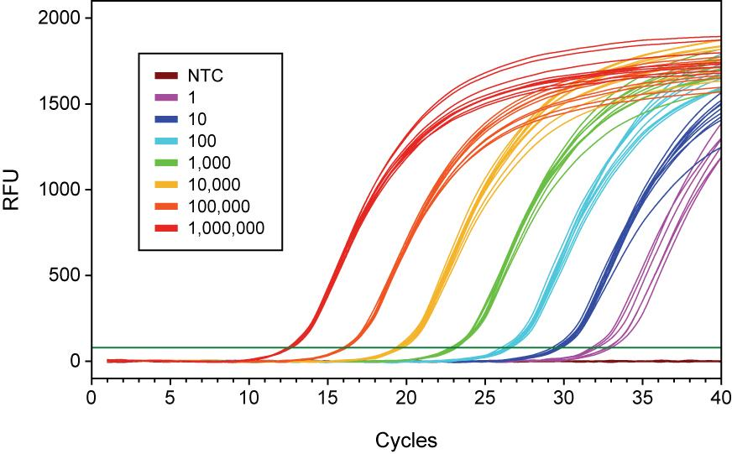
Real Time PCR
Widely used for monitoring response to therapy for viral infections (HIV, Hep B, HCV).
Rapid determination of colonization status for MRSA, VRE, and to diagnose C. difficile infections
http://image.slidesharecdn.com/quantitativereal-timepcr-130422105116-phpapp02/95/quantitative-real-time-pcr-3-638.jpg?cb=1366627930
http://www.5prime.com/media/438079/wide%20dynamic%20range%20and%20high%20sensitivity.jpg

Slide 32
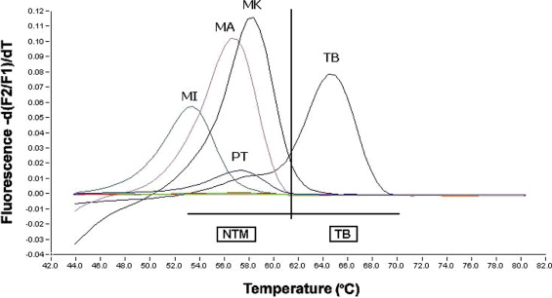
Figure 1 The post-amplification melt curve analysis of the broad-range mycobacterial PCR from formalin-fixed, paraffin-embedded tissue demonstrates that this patient (PT) has an infection caused by a nontuberculous mycobacteria (NTM). A post-amplification ...
Lulette Tricia C. Bravo , Gary W. Procop
Recent Advances in Diagnostic Microbiology
Seminars in Hematology, Volume 46, Issue 3, 2009, 248 - 258
http://dx.doi.org/10.1053/j.seminhematol.2009.03.009

Slide 33
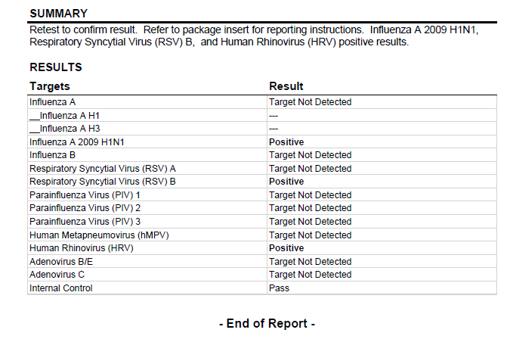
Good News! Multiplex PCR has largely replaced cell culture for respiratory viral diagnosis. Excellent sensitivity and specificity.
Bad News! Difficult to interpret multiple positive results, especially in pediatric populations.

Slide 34
Applications of Isothermal and Signal Amplification Methods
TMA/NASBA: Viral load testing, detection of M. tuberculosis, enterovirus detection
LAMP: ESBL and Shiga toxin detection, malaria, Campylobacter jejuni and C. coli.
LCR: gonorrhea and chlamydia diagnosis, tuberculosis, HPV, Listeria
LIPA: HCV and HBV genotyping, mutation analysis of HIV and mycobacteria, HPV subtyping

Slide 35
Fundamental Issues with Amplification Techniques in the Clinical Setting
False negatives due to presence of PCR inhibitors
Poor quality nucleic acid reduces sensitivity, e.g. formalin fixed tissue in paraffin blocks
False positives due to amplicon contaminants – especially with highly sensitive nested PCR.
Laboratory space, design and workflow needs to be carefully considered to be successful

Slide 36
Interpretation of Amplification Results
Interpretation of a positive result can depend on the specimen type. e.g. positive HSV PCR from spinal fluid versus bronchial lavage.
DNA may be detected for some time after infection has resolved. When is repeat testing appropriate for test of cure?
For the same reason that “pan culturing” is not always appropriate for a febrile patient, a “shotgun” approach to ordering molecular tests is expensive and can be misleading.

Slide 37
Mass Spectrometry for Organism Identification
The Age of Proteomics Enters the Clinical Microbiology Laboratory

Slide 38
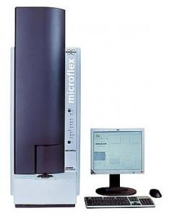
MALDI-TOF
Matrix Assisted Laser Desorption Ionization Time-of-Flight Mass Spectrometry
The instrument consists of a platform, a tube, a laser and a detector
Purpose: Rapid automated identification of bacteria, yeast and molds

Slide 39
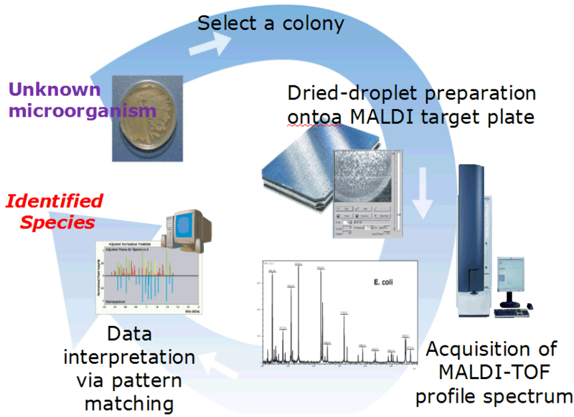

Slide 40
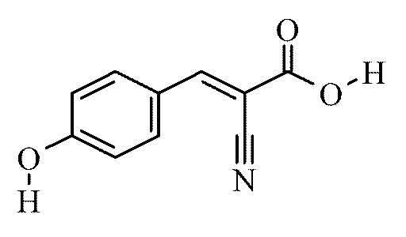
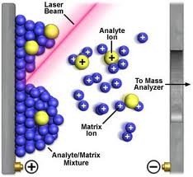
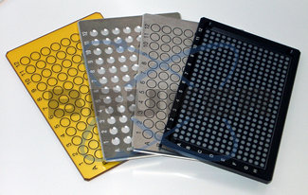
MALDI-TOF Ionization
alpha-cyano-4-hydroxy cinnamic acid
- crystalizes out on the steel plate along
with the analyte
- chromophore to absorb energy from laser
- desorption of matrix and analyte occurs
on surface
- soft ionization results in M-H+ with only
one plus charge per molecule

Slide 41
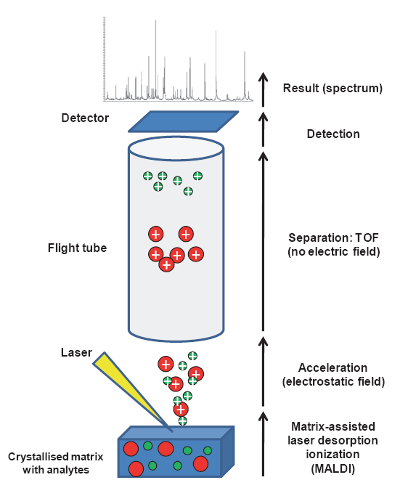
How it Works
Organism placed on plate, macromolecules extracted with formic acid and embedded in matrix
Cells ionized with laser, accelerated up tube
Time for ions to reach detector is measured

Slide 42
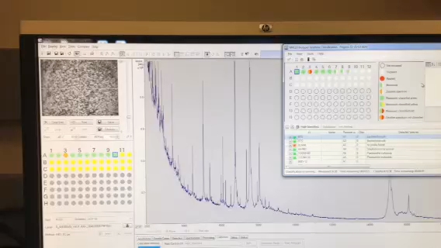

Slide 43
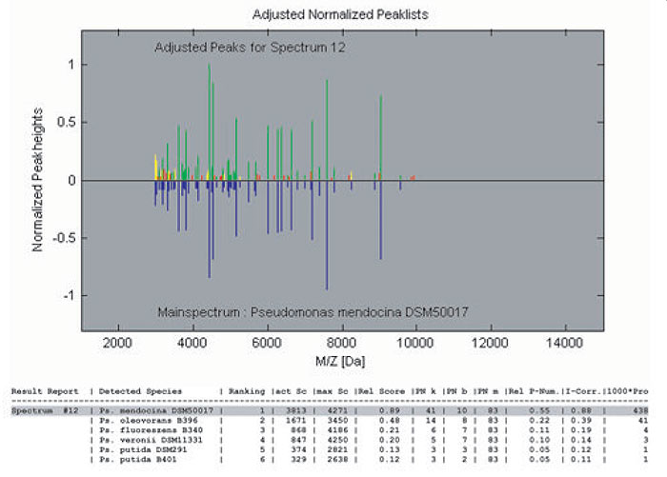
Peak Matching Algorithm

Slide 44
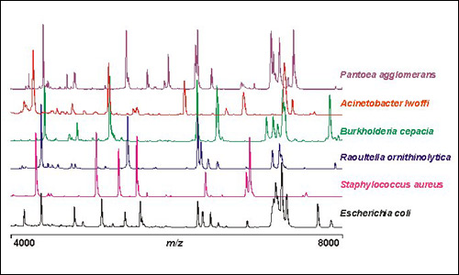
Data Analysis
Each ion represented as peak on graph
Each organism forms a unique fingerprint
Database of over 5500 organisms
Identification < 30 seconds

Slide 45
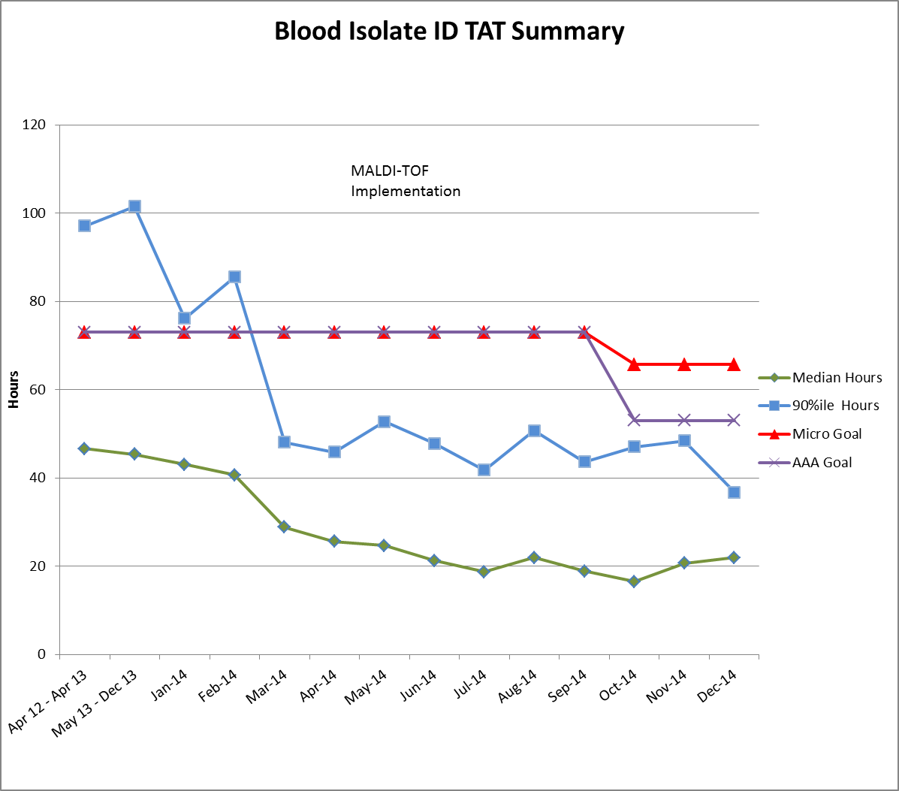
Impact of MALDI-TOF on Time to Identification for Blood Pathogens – University of Wisconsin

Slide 46
MALDI-TOF – Pros and Cons
Pros
Cons
Excellent identification profiles for bacteria, yeast and many molds
Fast and cost effective (limited consumable reagents)
Has potential for expanding applications beyond identification, e.g. susceptibility testing
By identifying multiple organisms to the species level, clinicians may give undue significance to endogenous flora.
Expensive instrument for labs with low volumes

Slide 47
Molecular Epidemiology for Outbreak Investigations
Phenotypic Methods- prone to variability
  Bacteriophage Typing
  Antimicrobial Susceptibility or “Antibiogram”
Genetic Methods - more stable
  Restriction Endonuclease Analysis of Plasmids
  Ribotyping
  Pulsed-field Gel Electrophoresis (PFGE)
  Multi-locus Sequence Typing (MLST)

Slide 48
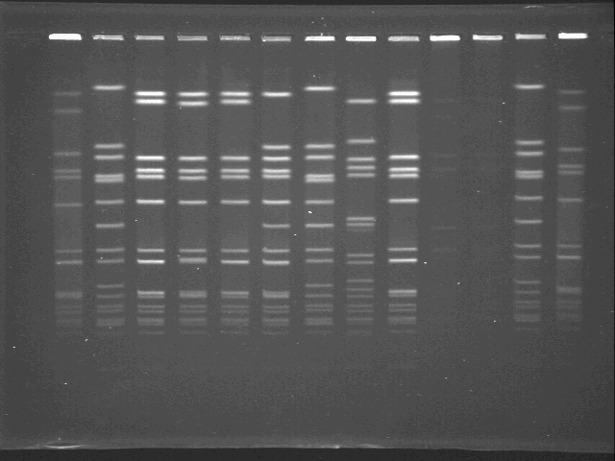
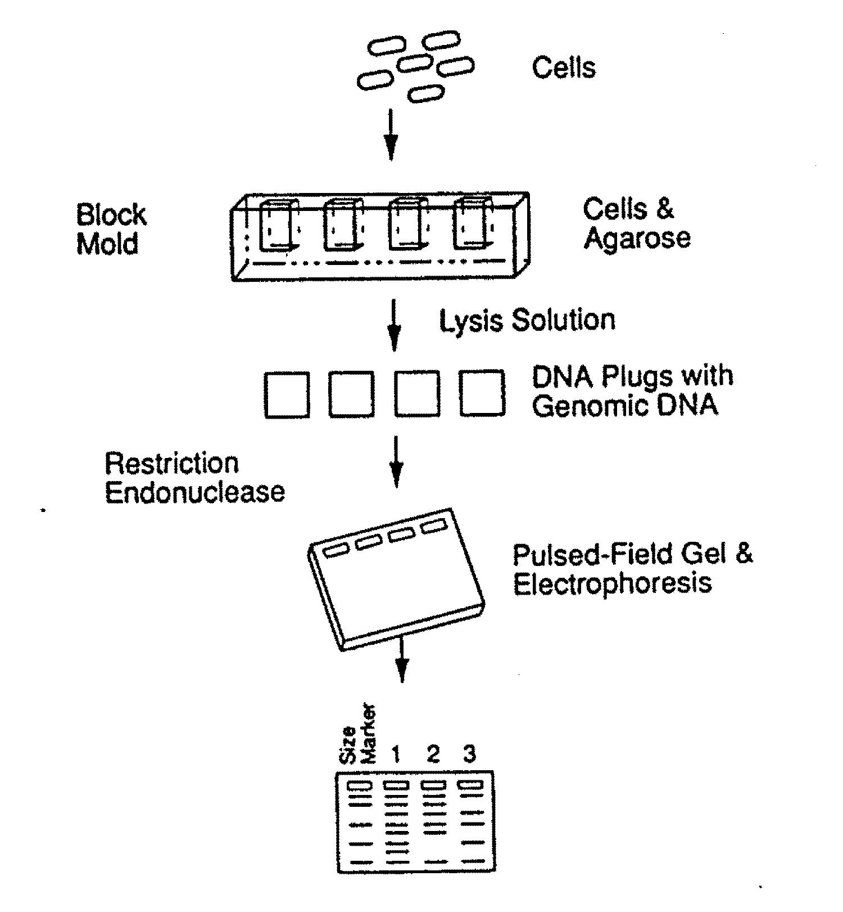
PFGE Typing Method

Slide 49
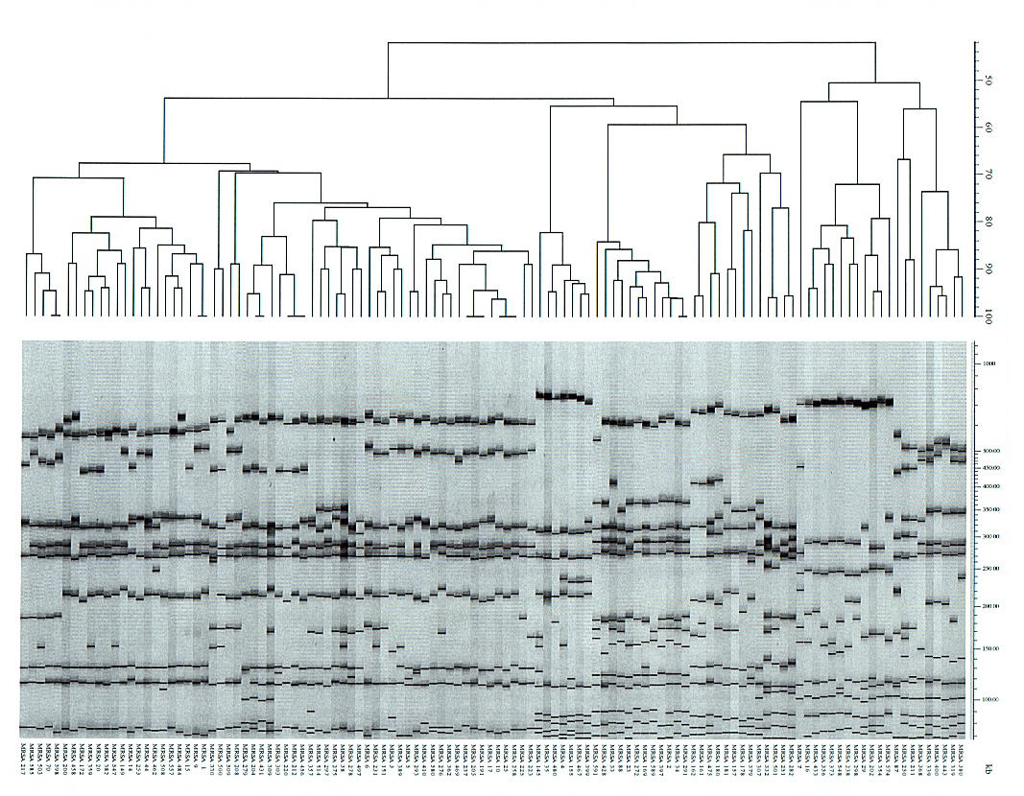
MRSA Pulsed-field Gel Electrophoresis (PFGE) Dendrogram
116 SmaI genotypes
27 clonal groups

Slide 50
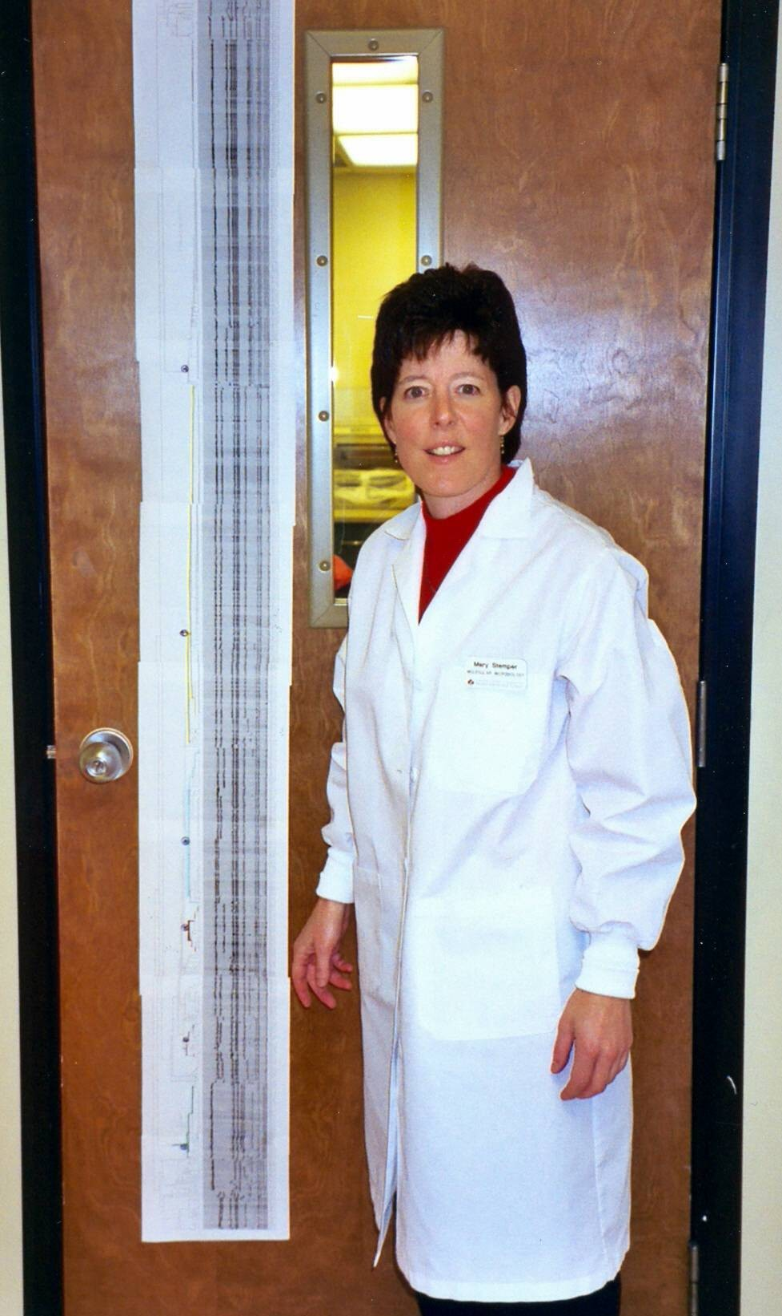
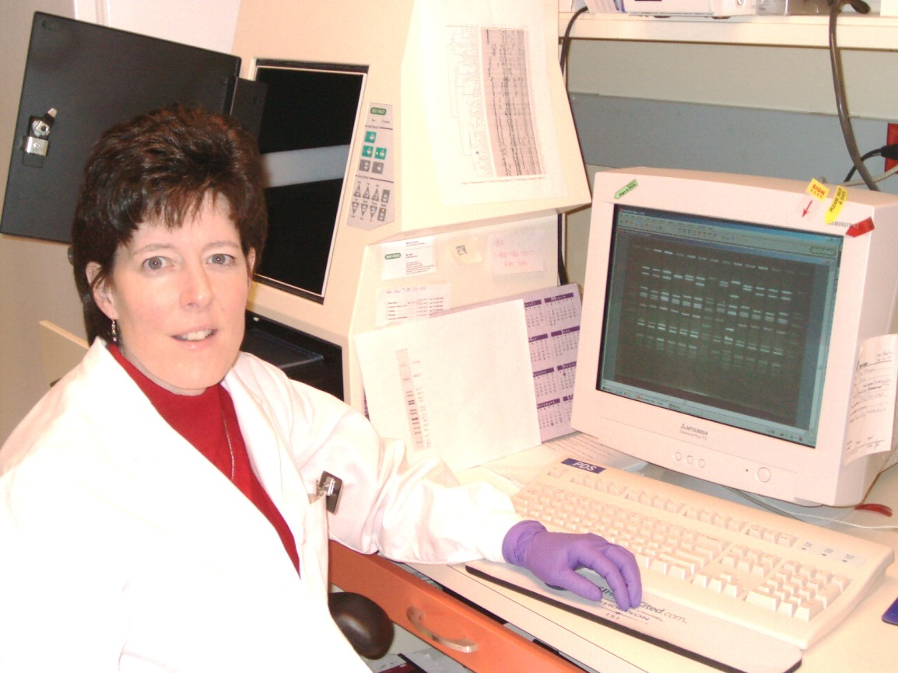
Mary Stemper, M.S.
PFGE guru

Slide 51
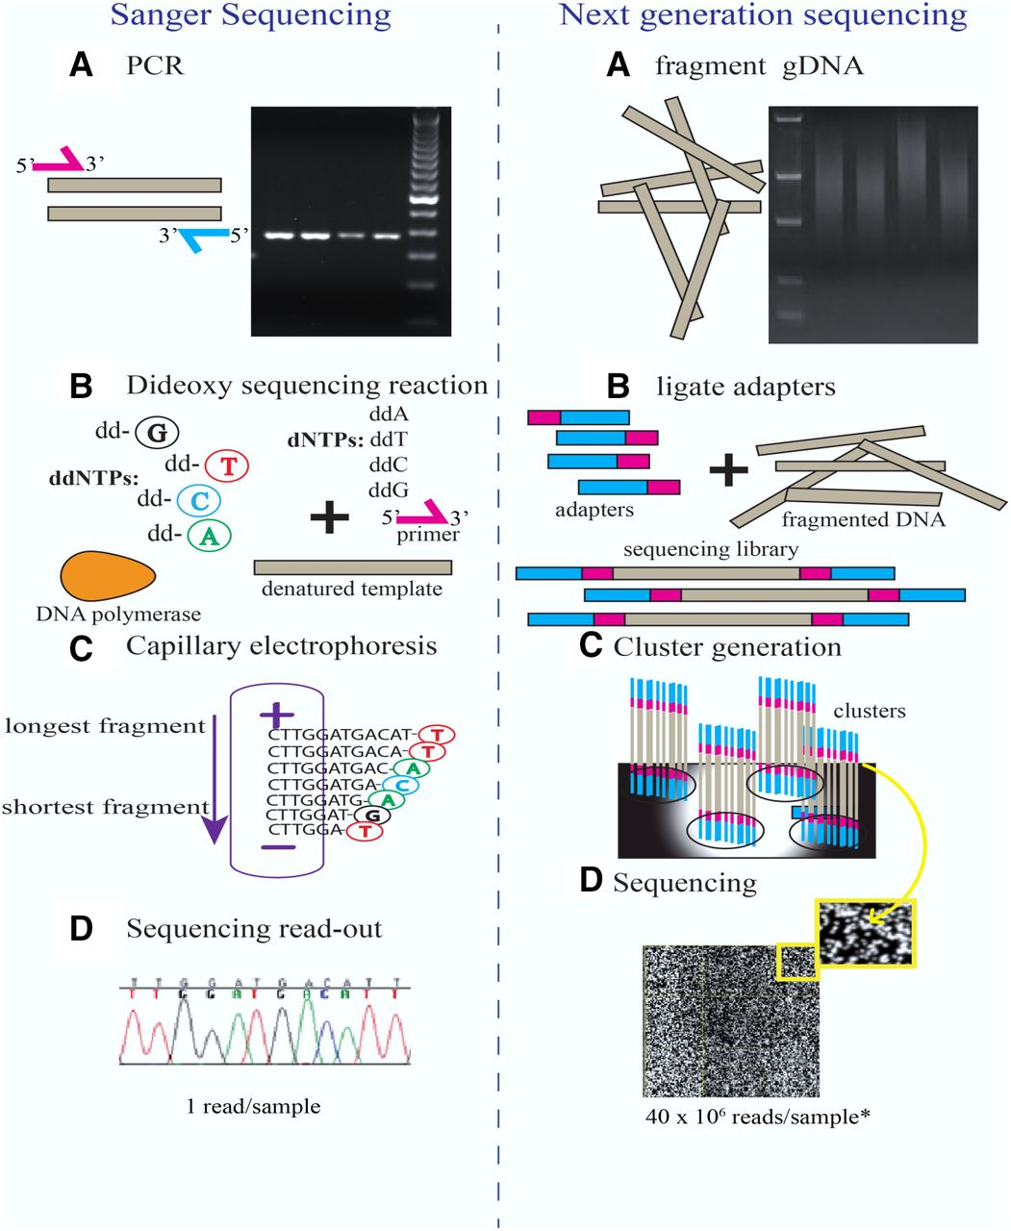

Slide 54
Selected References
Malhotra S., et al. Molecular Methods in Microbiology and their Clinical Application. J Mol Genet Med 2014;8:4 http://dx.doi.org/10.4172/1747-0862.1000142
Cobo F. Application of molecular diagnostic techniques for viral testing. Open Virol J 2012:6;104-114.
Patel R. MALDI-TOF MS for the Diagnosis of Infectious Diseases. Clin Chem 2015:61(1):100-11:doi: 10.1373/clinchem.2014.221770. Epub 2014 Oct 2.
Schuster SC. Next-generation Sequencing Transforms Today’s Biology. Nature Methods 2008:5;16-18.

Slide 55
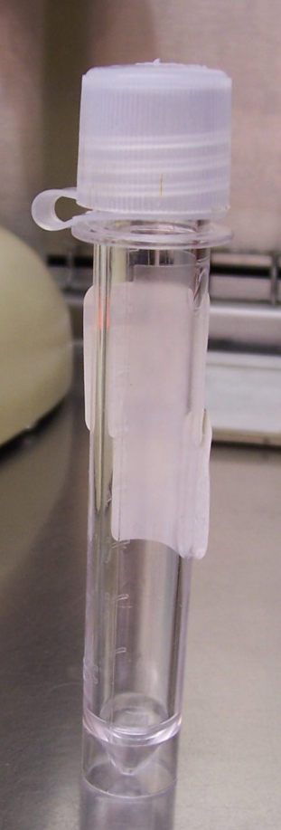
Direct Specimen Bacterial ID by 16S PCR
24 yr old female presents with meningitis – spinal tap post antibiotics
  Gram = Moderate WBC’s,
  No microorganisms
  Culture = No growth
  16S PCR = 100%
  Neisseria meningitidis

